Slide 1
Loops through loops: how crochet can model discrete mathematics
Elsa Vosganian
CS 131 Fall 2025 Semester Project
Pierce College
Notes:
Hello! My name is Elsa and this is my presentation for my Discrete Structures class. I wanted to demonstrate how crochet could be used to model some of the concepts we learned in class, like sequences, algorithms, and pseudocoding.

Slide 2
Overview
What is crochet?
Fiber art history
Sequences and algorithms in crochet
Modeling circles and spheres with crochet
Modeling fractals with crochet
Try it yourself!
Notes:
Here’s a quick overview of what I would like to go over in my presentation:
I’m going to define what crochet is,
Go over a brief history of fiber arts and its relation to computing,
What kinds of sequences and algorithms appear in crochet patterns,
How you can create circles and spheres in crochet,
Some other types of mathematical concepts that can be modeled in crochet,
And a quick pattern for anyone interested in the craft!

Slide 3
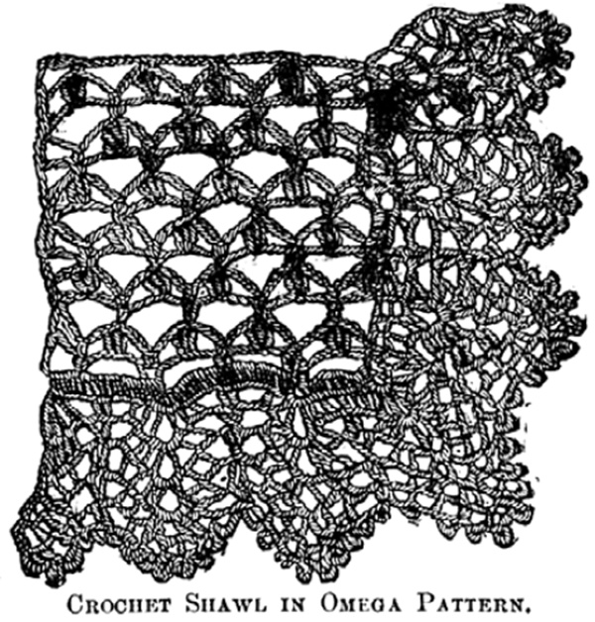
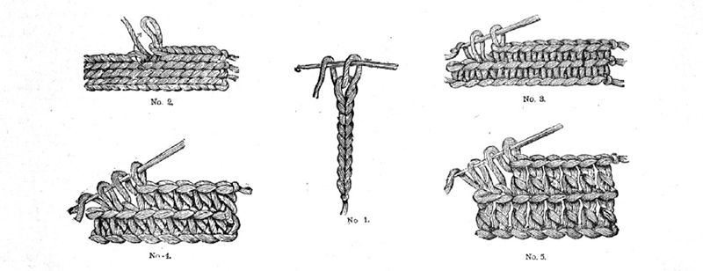
What is crochet?
“Needlework consisting of the interlocking of looped stitches formed with a single thread and a hooked needle”- Meriam Webster
Crocheted fabric is generally thicker than knit fabric and slightly holey
Some Victorian era crochet diagrams from Piecework Magazine
Notes:
So, what is crochet?
A formal definition for crochet is “needlework consisting of the interlocking of looped stitches formed with a single thread and a hooked needle.”
My go-to informal definition is that crochet is pulling loops through loops with a hook to make fabric.
Crochet is different from knitting because knitting uses two needles, while crochet uses one hook.
Here we have some images of Victorian era crochet diagrams: some of the basic types of stitches, and a portion of a shawl.
Crochet fabric is typically thicker than knit fabric, but has a lot more holes.
It’s very lace-like, which we’ll get to in a moment.

Slide 4
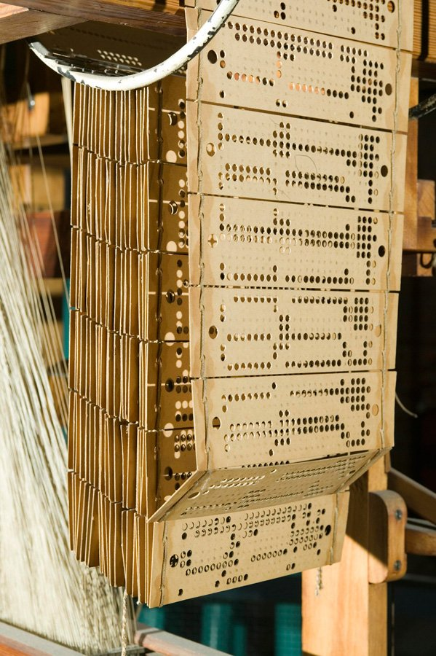
Very brief history of fiber arts
Most fabric and fiber products were made by hand, up until the Industrial Revolution
The Jacquard loom was patented in 1804, which automated the weaving process and made fabric cheap and accessible
This was programming before modern-day computers! The loom used punch cards which told the loom what fabric designs to make
Crochet began to appear in the 16th century as a lace-making artform
Modern crochet has its origins in the 18th century; a relatively recent artform compared to weaving
Weaving and knitting have been replicated by machines, but crochet has not!
Jacquard loom punch cards from The Science and Industry Museum
Notes:
Here is a very brief history of fiber arts, mostly with a focus on how crochet came to be.
Up until the Industrial Revolution, most fiber art was made by hand. People had specific professions related to the craft, and it was significantly time consuming.
The invention of the Jacquard loom helped to automate the production of woven fabric, including pre-programmed fabric designs.
This was programming before modern-day computers! The loom would take an input of a paper punch-card, and the holes in the card would tell the loom what fabric designs to make.
Back to crochet, the artform first appeared somewhere in the 16th century in the form of lace-making.
Modern-day crochet has its origins in the 18th century, which makes it a much newer artform than one would expect.
For fiber arts as a whole, weaving and knitting have since been replicated by machines, but crochet has not!
One would have to design a machine that replicates the human hand perfectly in order to automate crochet.

Slide 5
Crochet patterns and making algorithms
Crochet patterns are worked from the bottom up in rows, or from the inside out in rounds (rds).
A typical crochet pattern worked in rows is written like this:
Row 0: Start with a chain and an odd number of stitches
Row 1: Single crochet across, chain 1 and turn.
Row 2: Sc in second stitch from hook, *ch 1, skip stitch below, sc in next stitch. Repeat from * across row, make a sc in last stitch of row. Ch 1, turn.
Row 3: Sc in second stitch from hook, *ch 1, sk st below, sc in next ch 1 space below. Repeat from * across row, make a sc in the last stitch of row. Ch 1, turn.
Repeat row 3 for as long as you’d like!
Moss stitch pattern from Mama in a Stitch
Notes:
So, how does crochet relate to discrete structures?
Well, when you are creating something using crochet, you usually work from bottom to top in rows, or from the inside out in rounds.
Each row or round has some sequence of stitches, and typically rows or rounds are repeated partially or entirely throughout the entire pattern.
A typical crochet pattern worked in rows is written like so.
It gives you instructions on what stitches to make on each row.
For instance, Row 0 tells you how to initiate the pattern, and each row after that builds on the row before it.
I have pictures on the next slide that show what this pattern is describing.

Slide 6
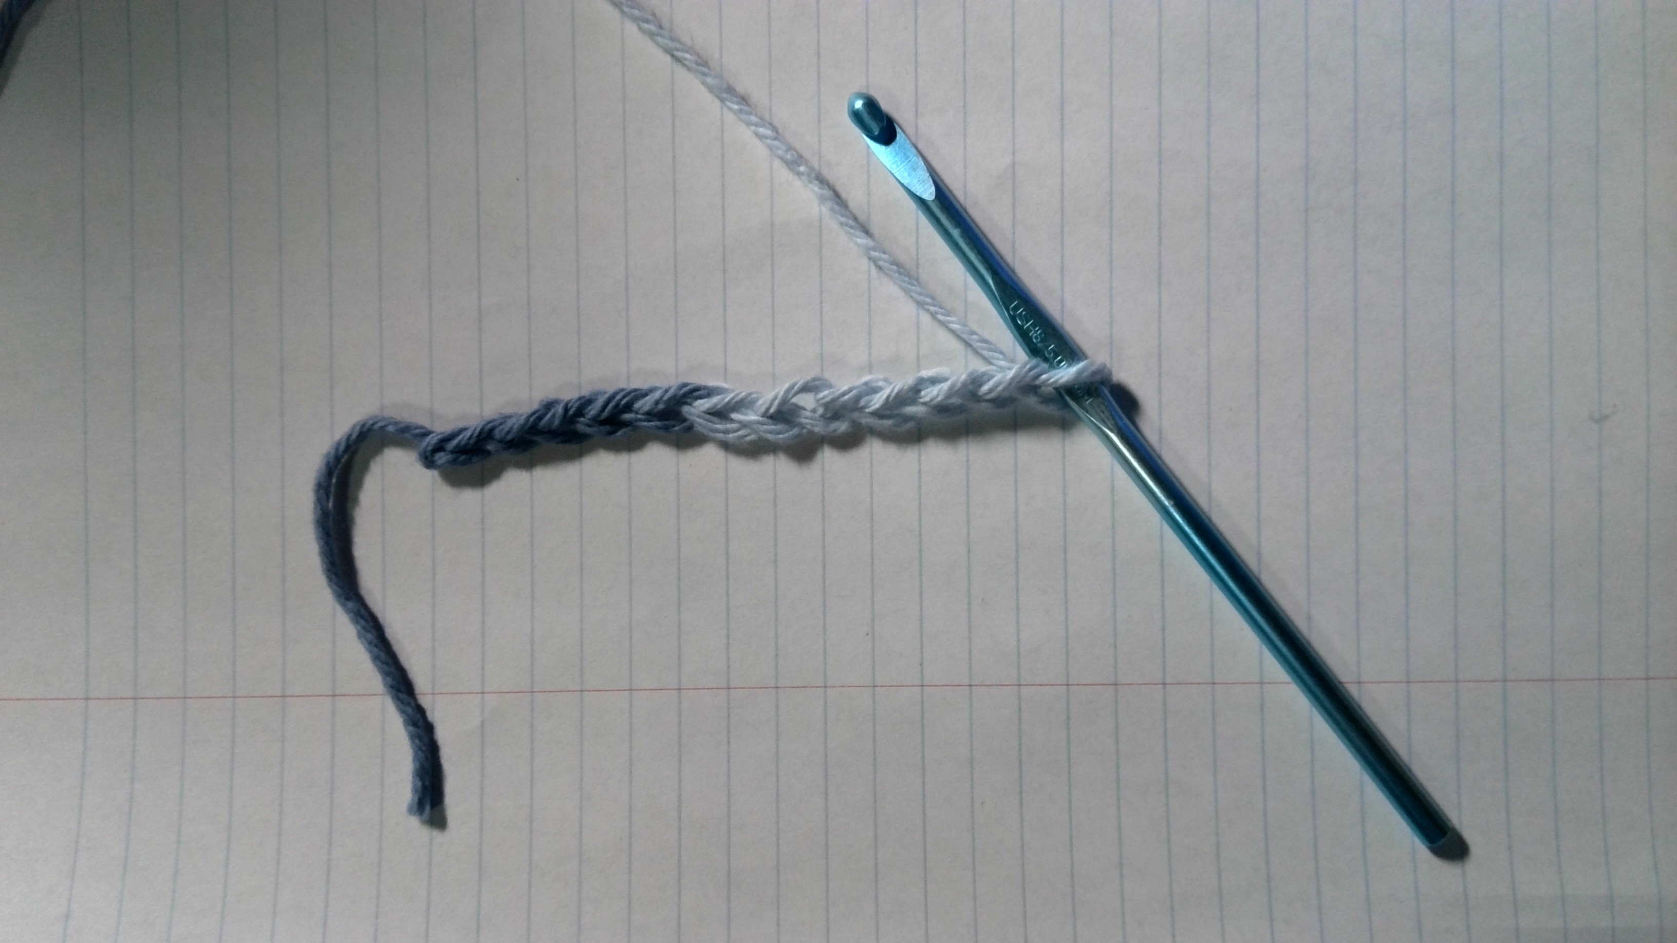
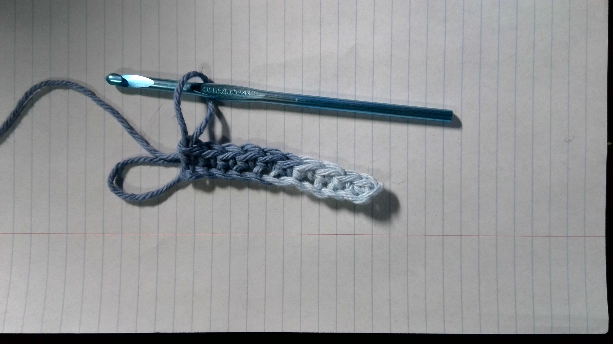
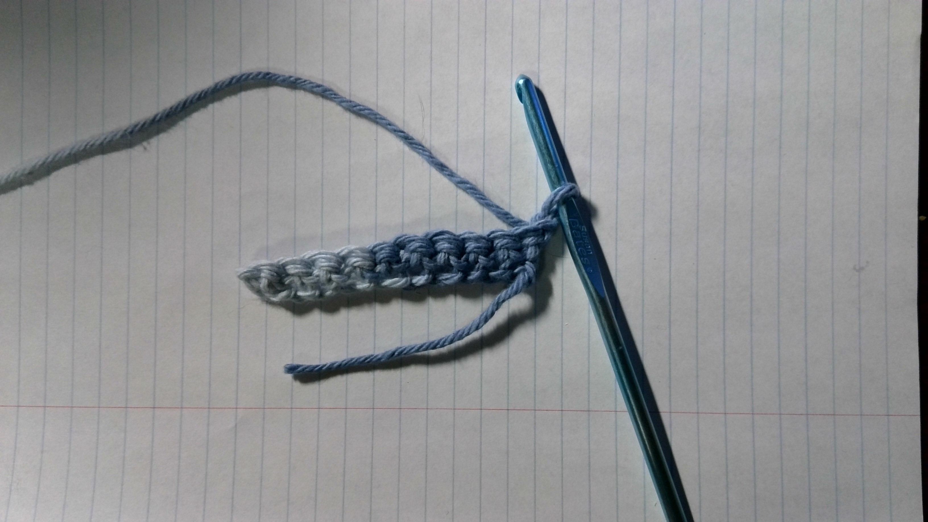
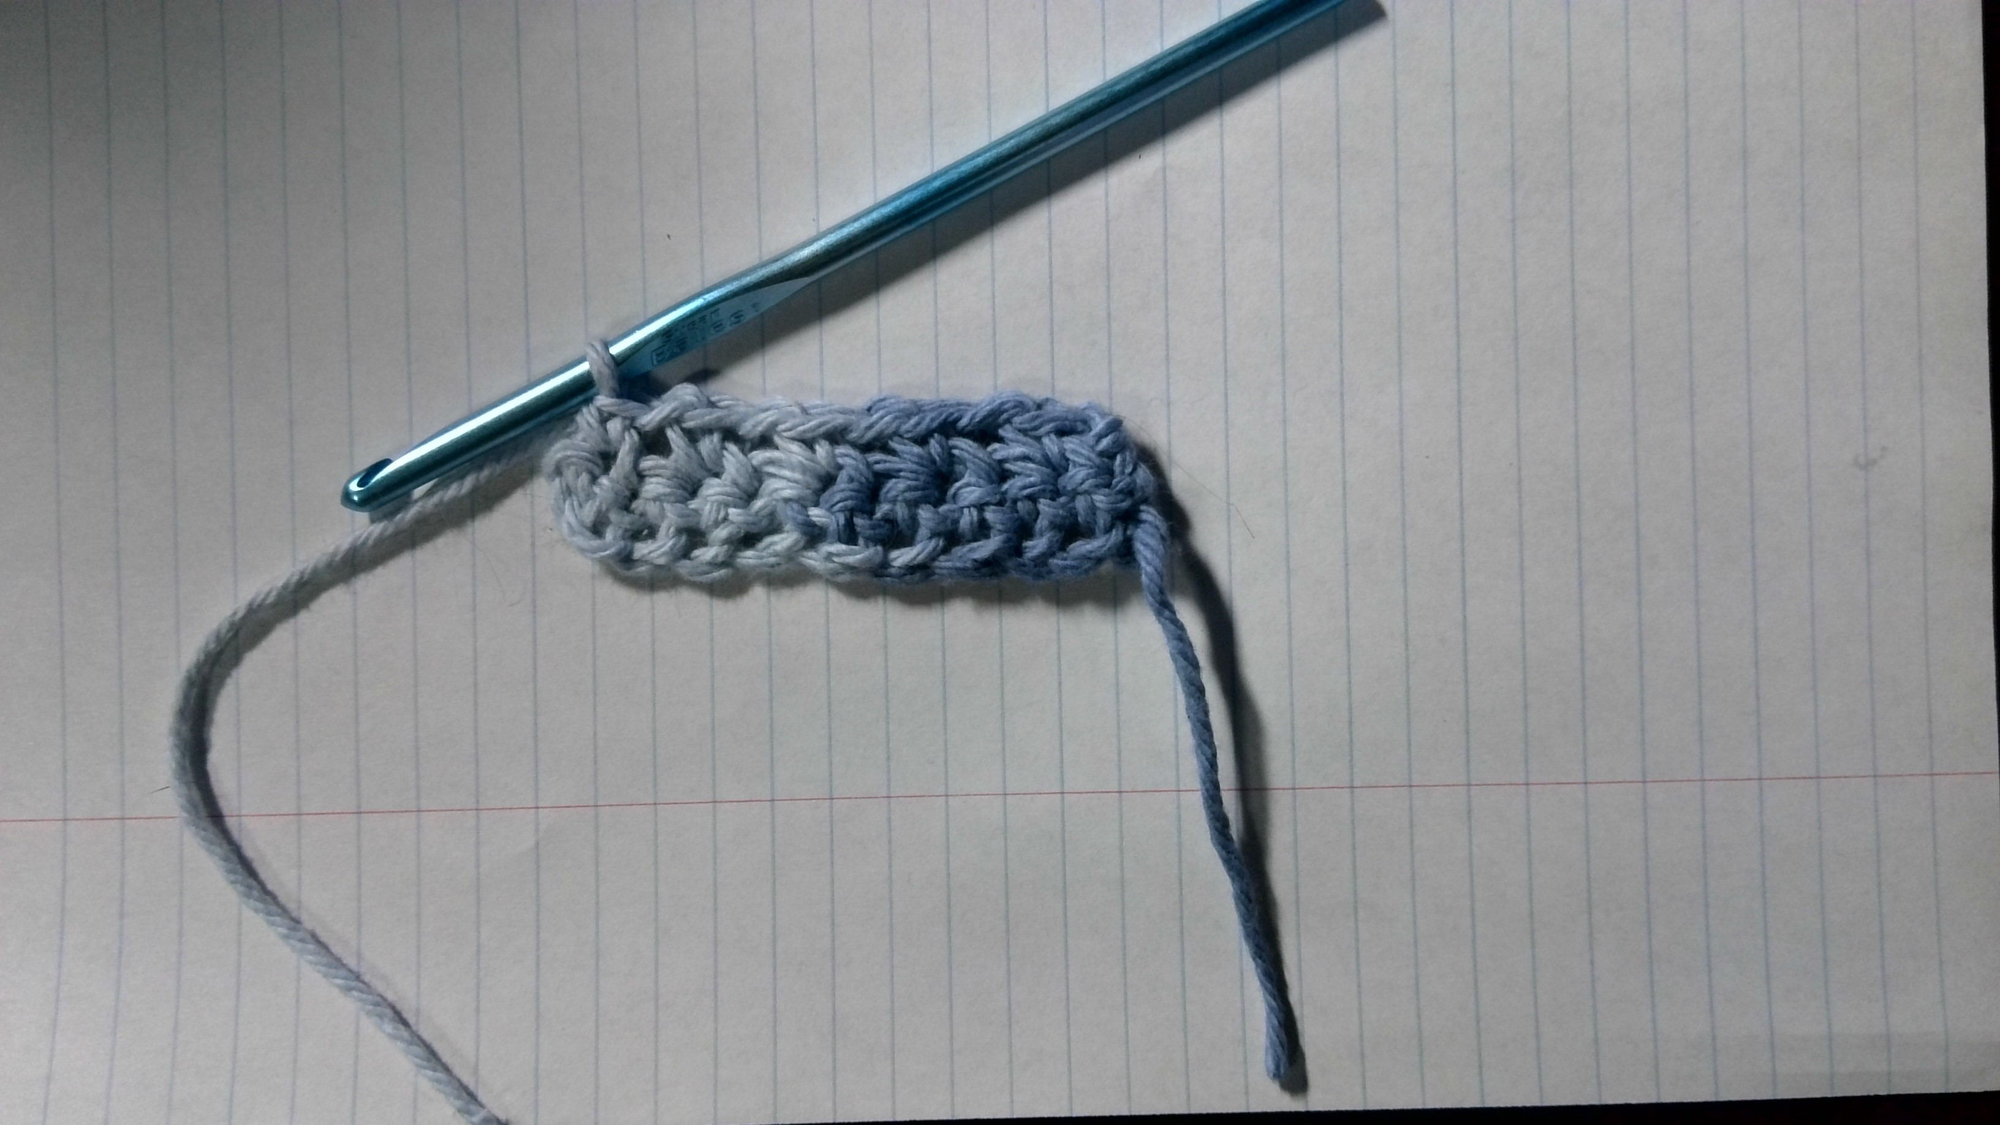
1. Making a foundation chain (ch)
2. Row 1: single crochet (sc) stitches
3. Back side of Row 1
4. Row 2: alternating single crochet stitches and chain stitches
Notes:
First we have a foundation chain of an odd number of stitches. This is our Row 0.
The next step asks to make single crochet stitches all the way across the foundation chain. When you’re right-handed, you work your stitches from right to left.
When you make it to the end of the row, you have to turn your work, which just means to flip it over so that you’re working right to left again.
Row 2 asks to alternate between single crochet and chain stitches, all the way to the end. This creates little gaps between each single crochet.

Slide 7
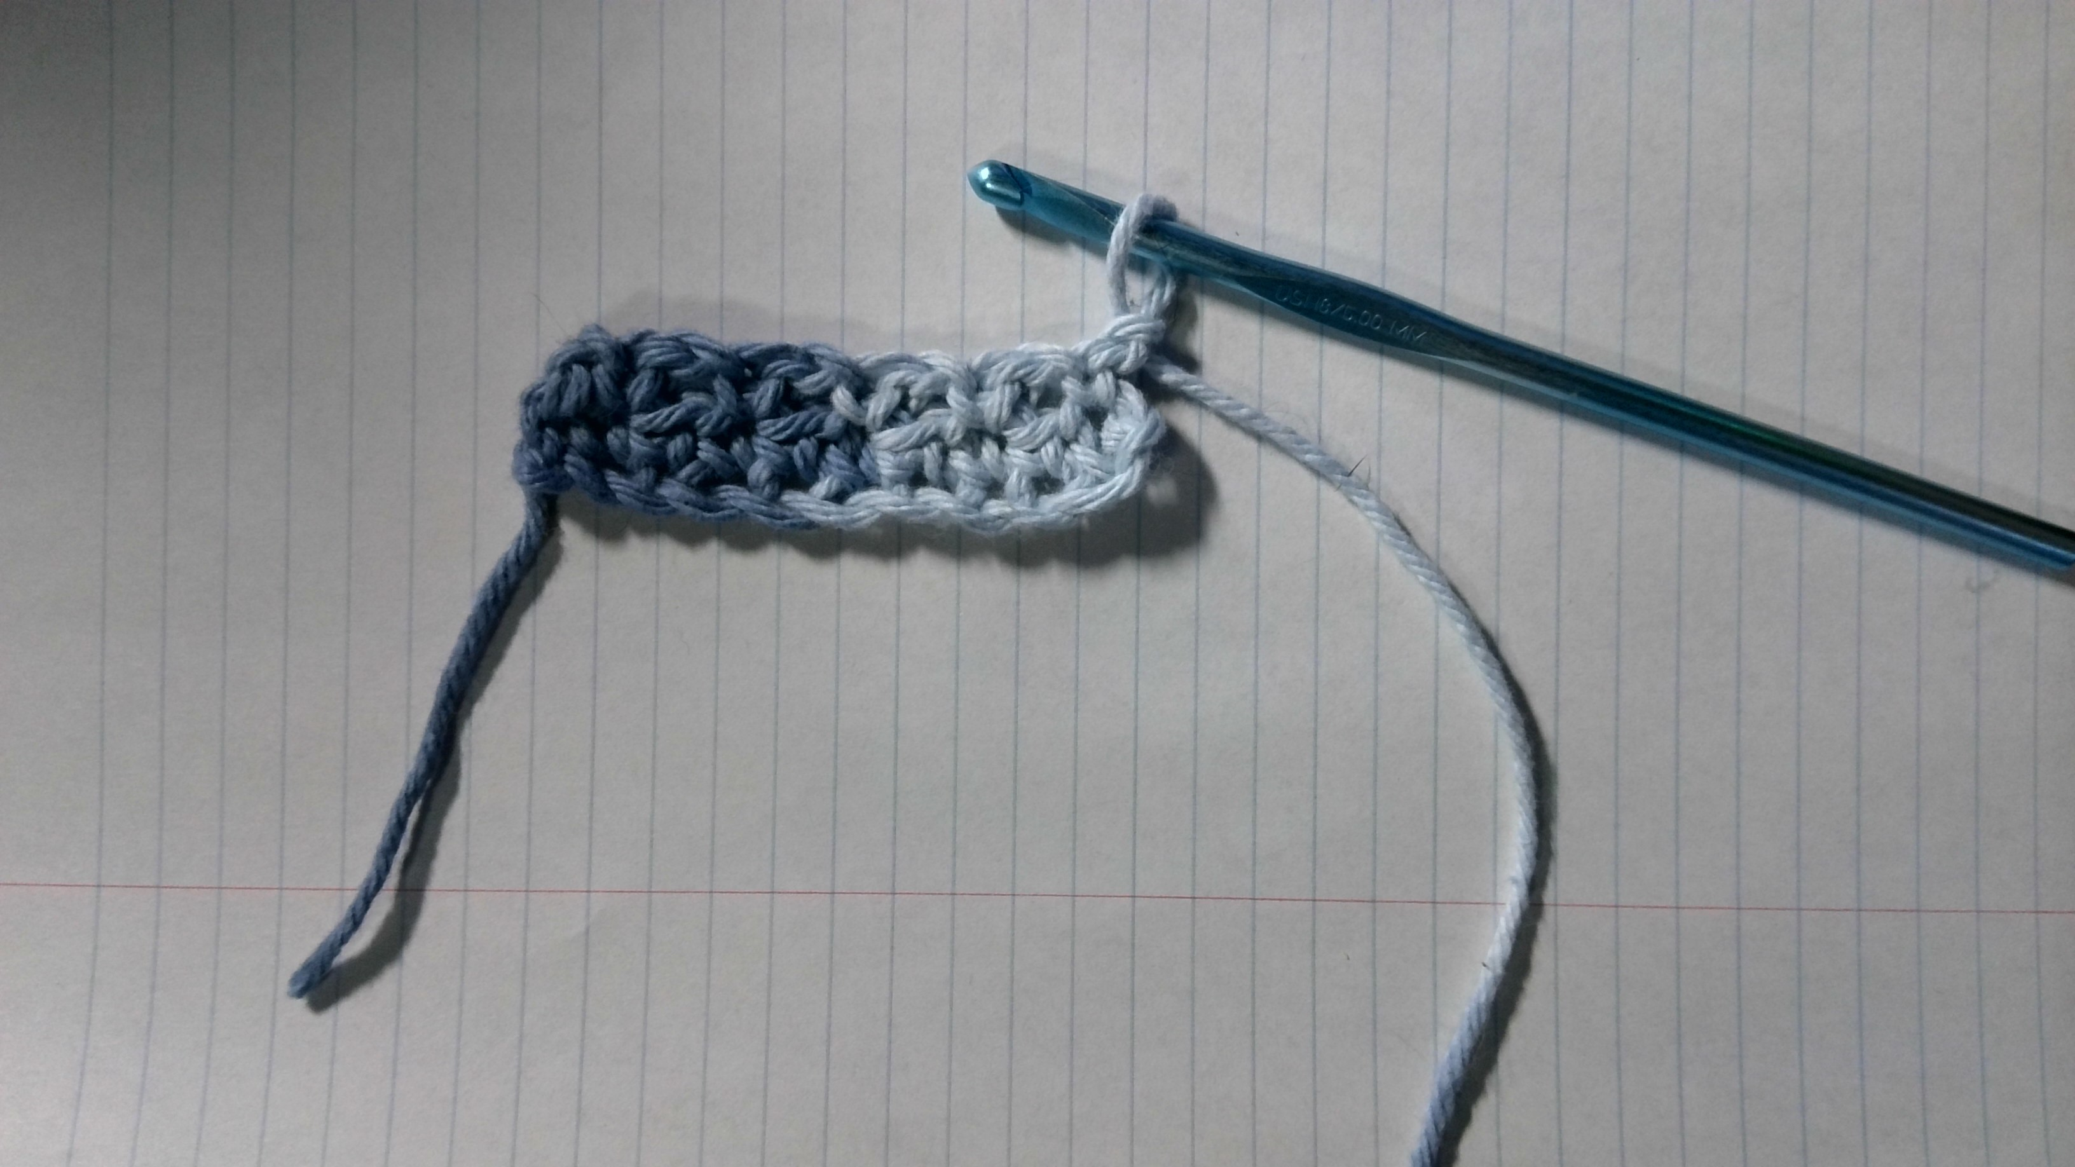
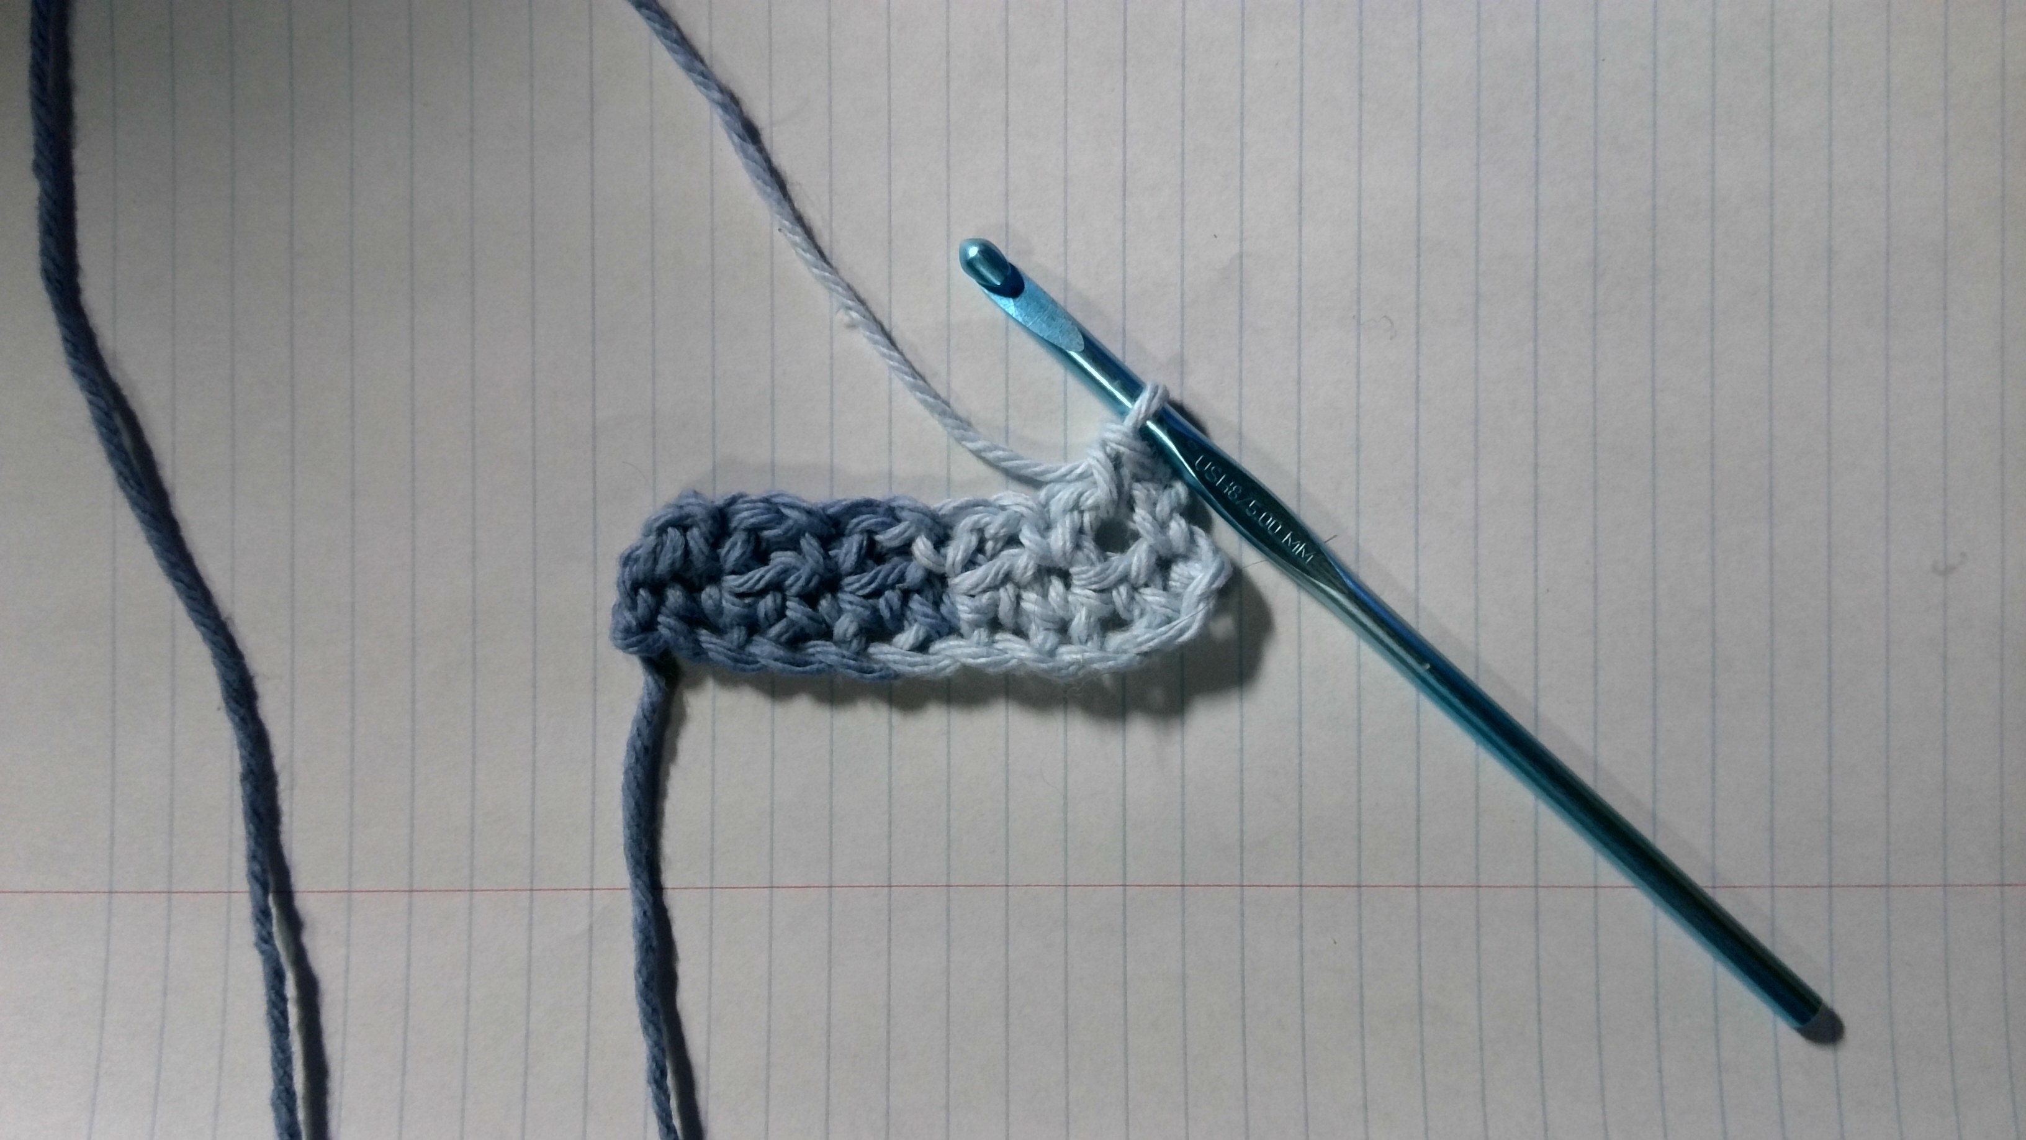
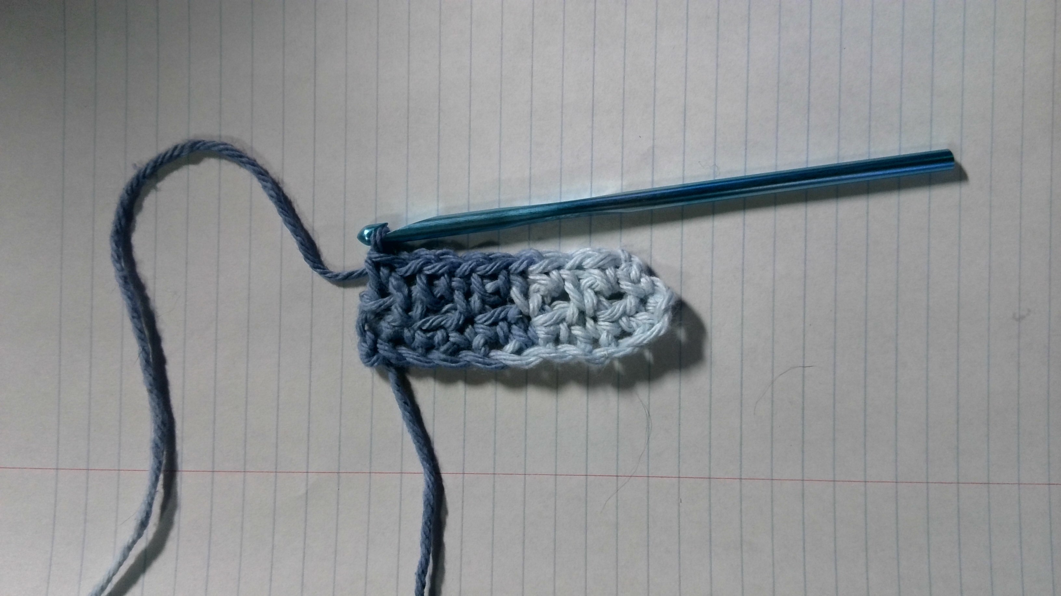
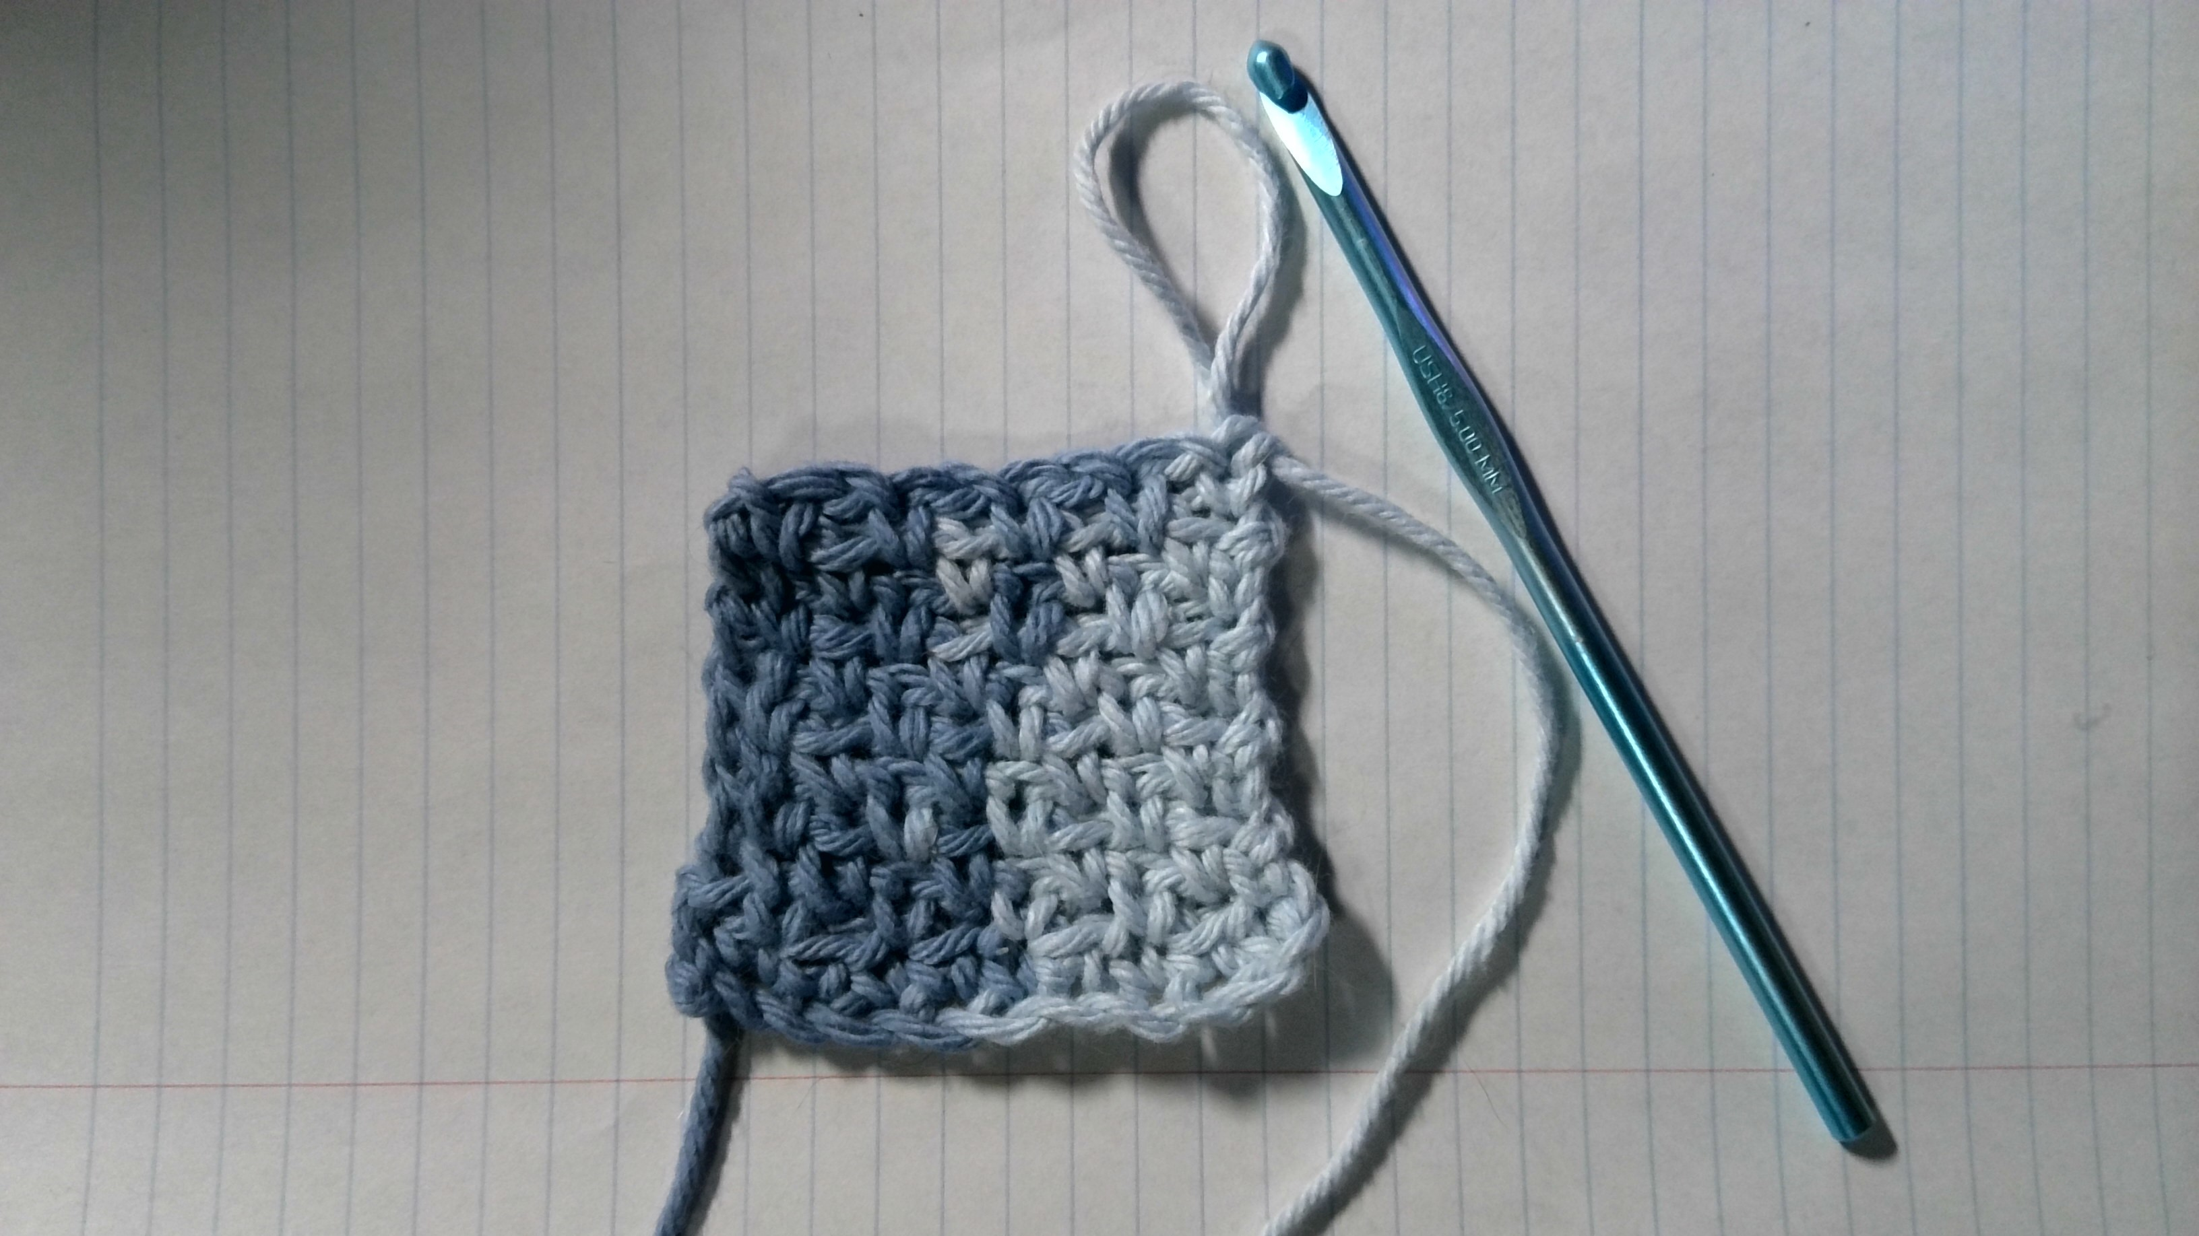
5. Back side of Row 2
6. Starting Row 3, the same as Row 2, but now stitches are worked into the gaps
8. As the sequence repeats, fabric with an interesting texture is created!
7. Row 3 is done!
Notes:
5. Picture 5 just shows that we’ve turned the work again.
6. Now when we start Row 3, we will now be working single crochet stitches into the gaps that we created on the previous row, and then make gaps for the next row.
7. Picture 7 shows what that looks like when we make our stitches all the way to the end.
8. If we were to continue this pattern, it starts to make an interesting looking fabric texture.

Slide 8
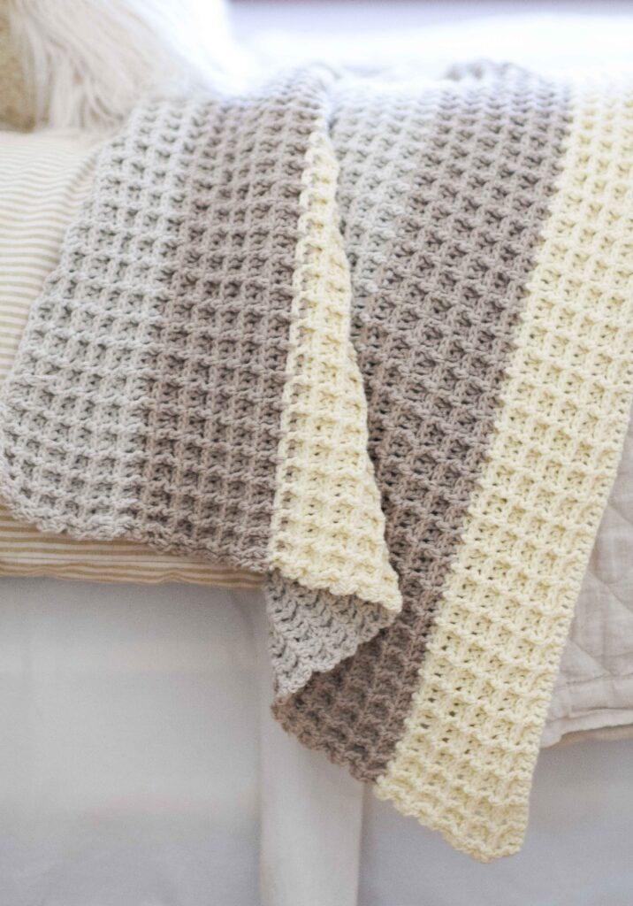
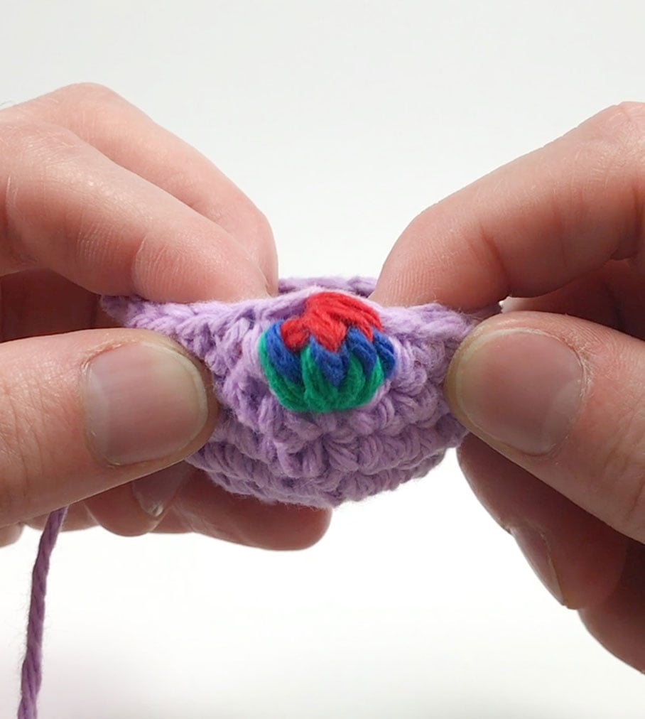
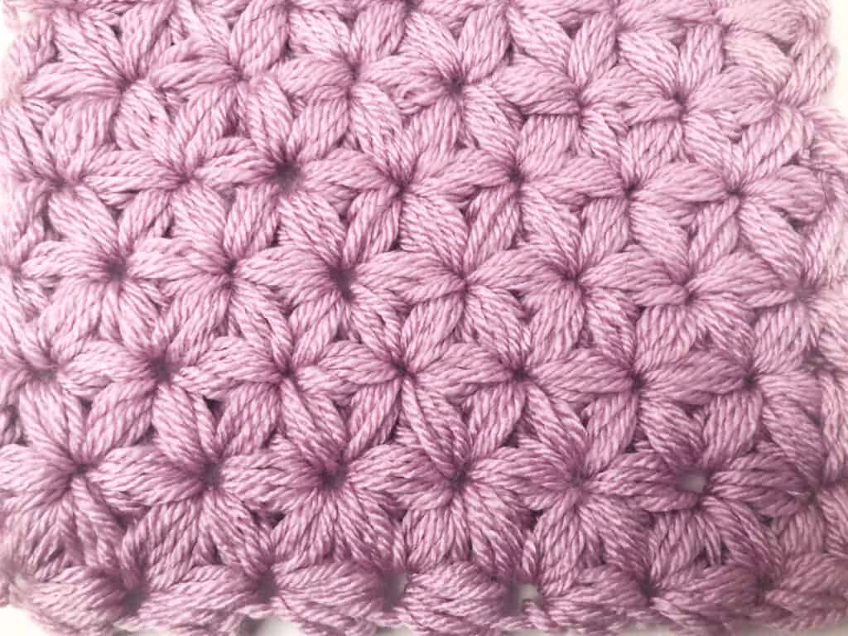
Showcase of textured fabric
Repetition of stitches in sequence can be translated as an algorithm!
Bobble stitch by Club Crochet
Jasmine stitch by Desert Blossom Crafts
Waffle stitch by Mama in a Stitch
Notes:
Here is just a small showcase of some fabric textures you can make with crochet.
All of these textured stitches have a written pattern that anyone can follow, and each one involves the repetition of some sequence or algorithm in order to get the desired texture.

Slide 9
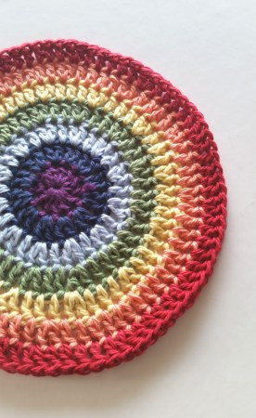
Modeling math with crochet: Circles
Rows vs rounds
Rows: working back and forth, usually to create a rectangular-shaped fabric
Rounds: working around a central point, usually to create a circular-shaped fabric
Making circles involves putting in more stitches each round with increase stitches: putting more than one stitch in the next stitch
Here is a general pattern for crocheting circles:
Round 1: 12 sts
Round 2: 2 sts worked into each st of Round 1 {24 sts}
Round 3: 2 sts worked into the first st, 1 st worked into the next st, repeated all the way around. {36 sts}
Repeat until desired size!
Crochet circle and pattern by Shelley Husband
Notes:
Besides textures, we can also make different shapes!
Before, we made a piece of fabric in the shape of a rectangle, but one could also make crochet in a circular shape.
This involves making stitches in a continuous circle.
When crocheting a rectangular piece of fabric, the number of stitches per row stays the same.
Though when working in a circle, the number of stitches needs to increase per row.
The technique for this is literally called an increase stitch, which means to make more than one stitch in the same spot.
For example, this rainbow circle starts with a purple center of 12 stitches.
The next round in dark blue has 24 stitches, which is 12 more stitches than the first round.
The third round in light blue has 36 stitches, which is 12 more stitches than the second round.
In this circle, each round’s stitch count is a multiple of 12, and making sure each round is a multiple of how many stitches you started with is important for making circles.
This can be easily written as a recursive algorithm, calling back to the number of stitches on the row previous.

Slide 10
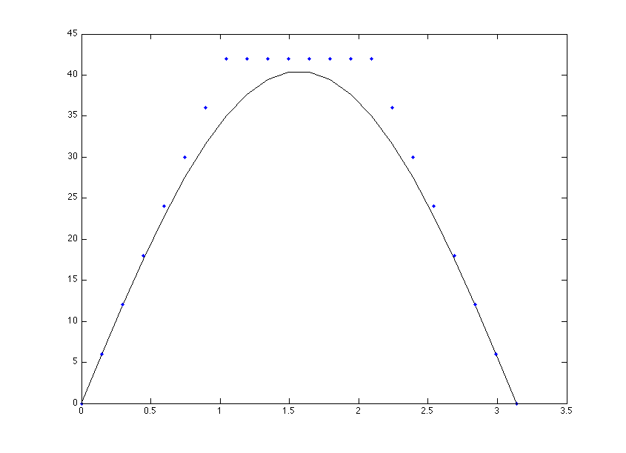
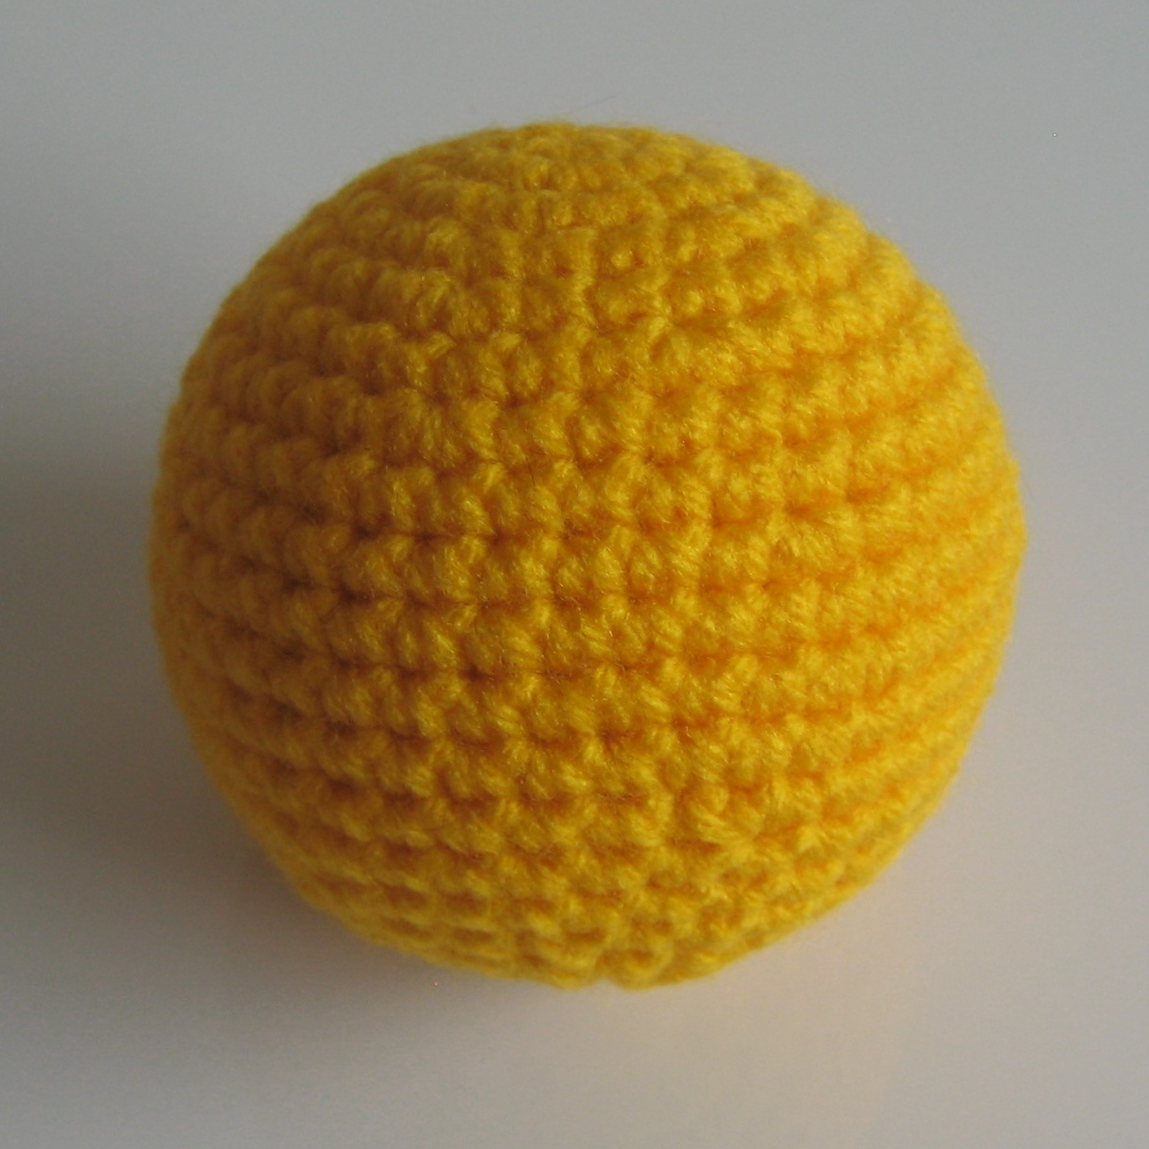
Modeling math with crochet: Spheres
A step up from making circles: making spheres!
Similar to making circles, the number of stitches increases each row
Towards the middle of the sphere, the number of stitches per row is the same
Finishing the sphere involves decreasing the number of stitches per row
Crochet sphere and graph by Ms. Premise-Conclusion
Notes:
Going a step up from making circles, we can make shapes with volume like spheres!
Here is a graph that demonstrates this perfectly.
Just like making a circle, you will first start with increasing the number of stitches in each row at a regular rate.
That is the line of dots on the left side of the graph, going upward incrementally.
Though at some point, the curve of the sphere has to level out, so we stop increasing the stitches.
This is represented by the horizontal line of dots at the top of the graph.
At this point the sphere will look like a cup.
In order to close off the sphere, you will need to decrease the number of stitches per row using decrease stitches.
Decreasing means to stitch two adjacent stitches into one, and eventually the rest of the curve of the sphere is formed.

Slide 11
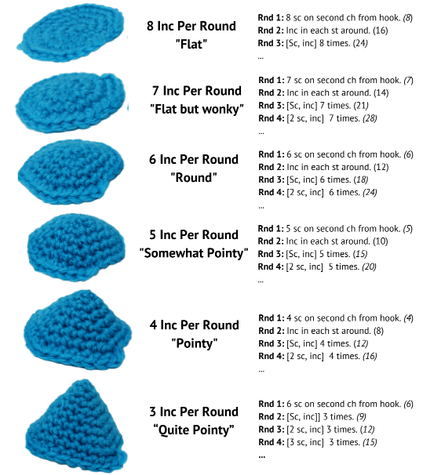
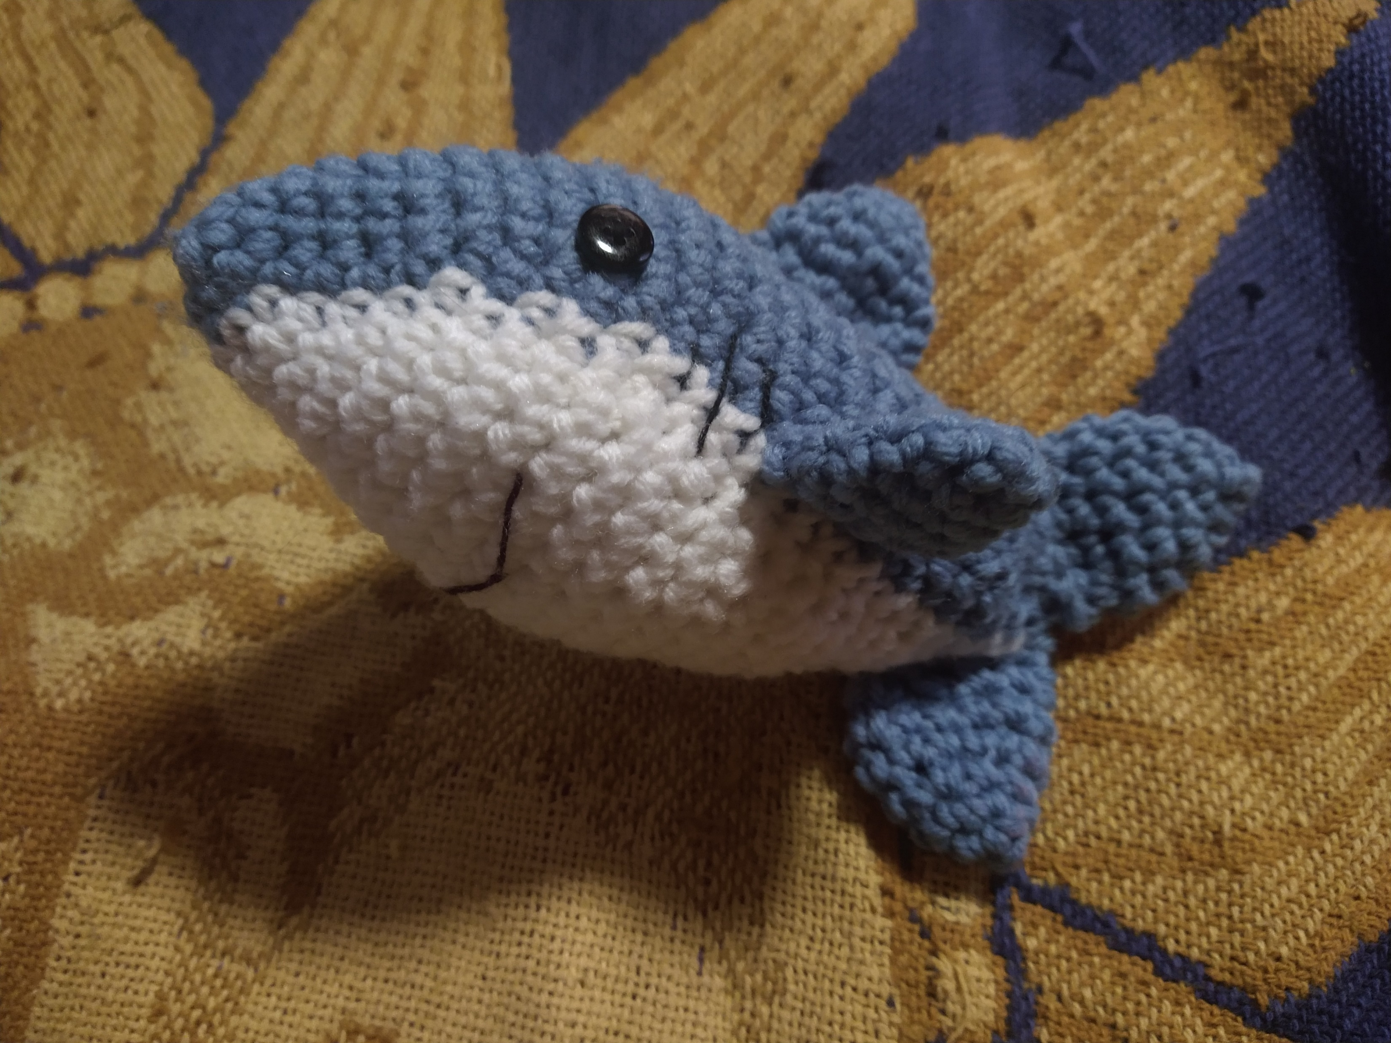
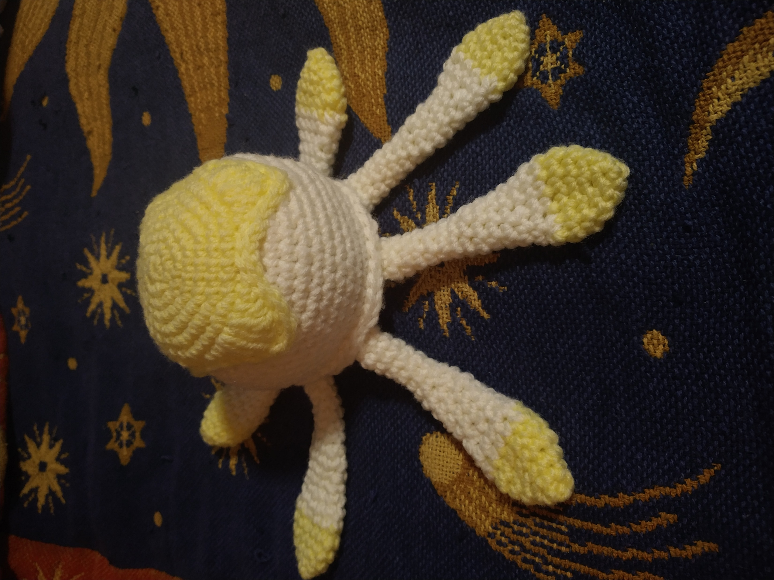
Amigurumi and 3D crochet
Amigurumi is a term for any hand-stitched plush or toy
The shape is in the math!
Insert crochet shark and jellyfish 😊
Amigurumi shark and jellyfish by me!
Amigurumi shape guide by Hooked by Kati
Notes:
It turns out if you change the number of stitches you start with, and the number of stitches you increase by each round, you can make lots more shapes than just spheres.
There’s a certain section of crochet called amigurumi, which is to make plushies, toys, or any three-dimensional shape from crochet.
This guide on the right goes over the general idea of making different shapes with amigurumi.
If you wanted a flat circle, the trick would be to start with 8 stitches and increase the number of stitches with multiples of 8.
But if you wanted something pointier, you could start with less stitches and use a smaller number as a base multiple.
For instance, the nose of the shark I made had to be very pointy, so I started with 6 stitches and increased by 3 each round.
The bell of the jellyfish had to be quite round, so I did things by multiples of 6.

Slide 12
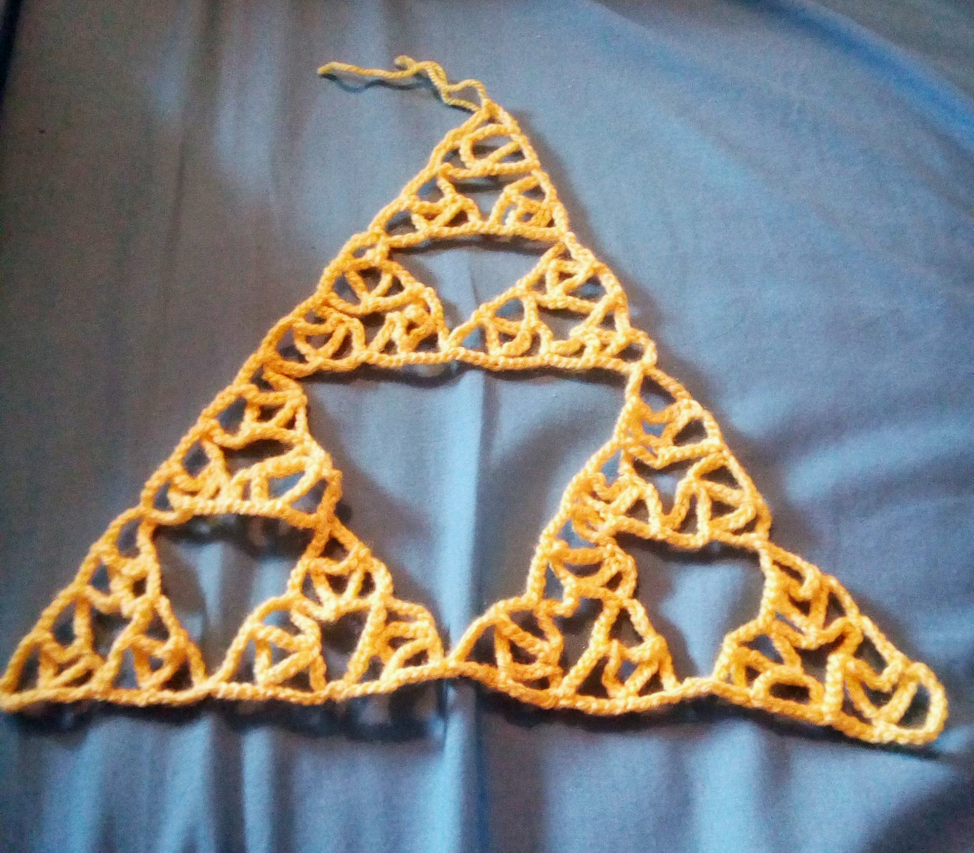
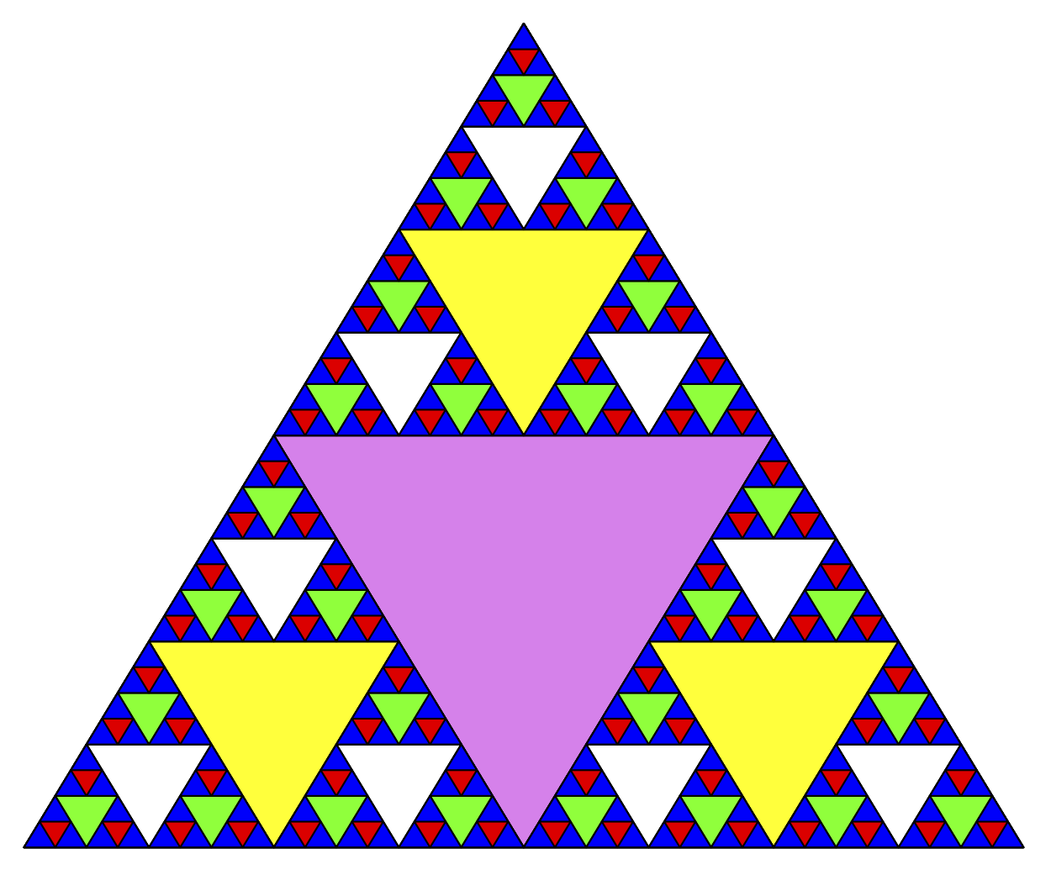
Modeling math with crochet: Fractals
Fractals are infinite geometric patterns
Although we can’t use infinite thread to represent an entire fractal, one example that works with limited thread is the Sierpinski triangle
Some have made blankets referencing the golden ratio!
Sierpinski triangles by Felix Stokes, Runestone Academy
Notes:
There are more complicated mathematical concepts that can be modeled with crochet too.
Fractals are a very interesting pattern in math, in that they take a geometric shape and expand infinitely outward or infinitely inward.
It’s very tricky to simulate an entire fractal, but many people have illustrated them in sections, like this crocheted Sierpinski triangle.
The person behind this creation made it with one continuous thread too!
Though I think an easier way to model these concepts is with a large piece of fabric and stitch the design onto them, as a lot of people have done with the golden ratio and the Fibonacci sequence.

Slide 13
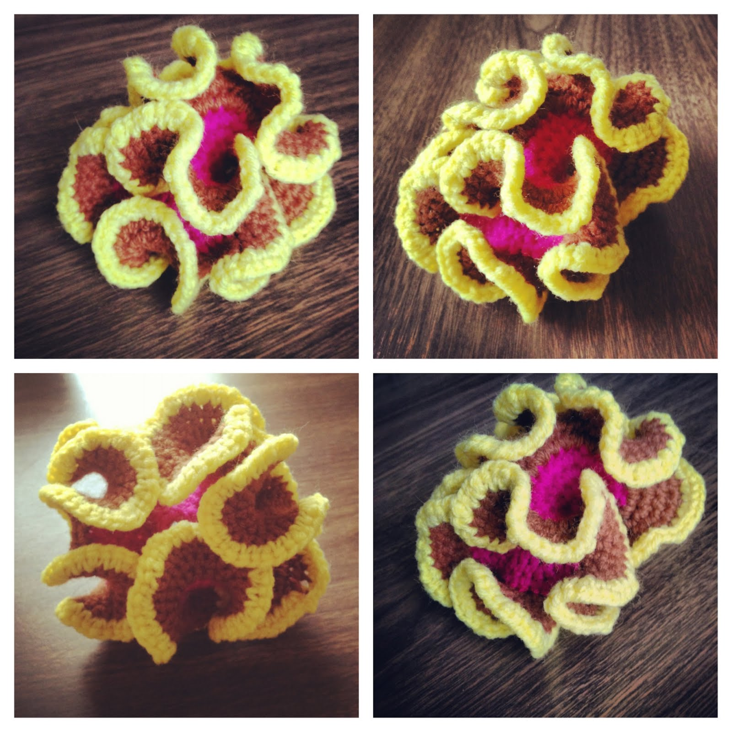
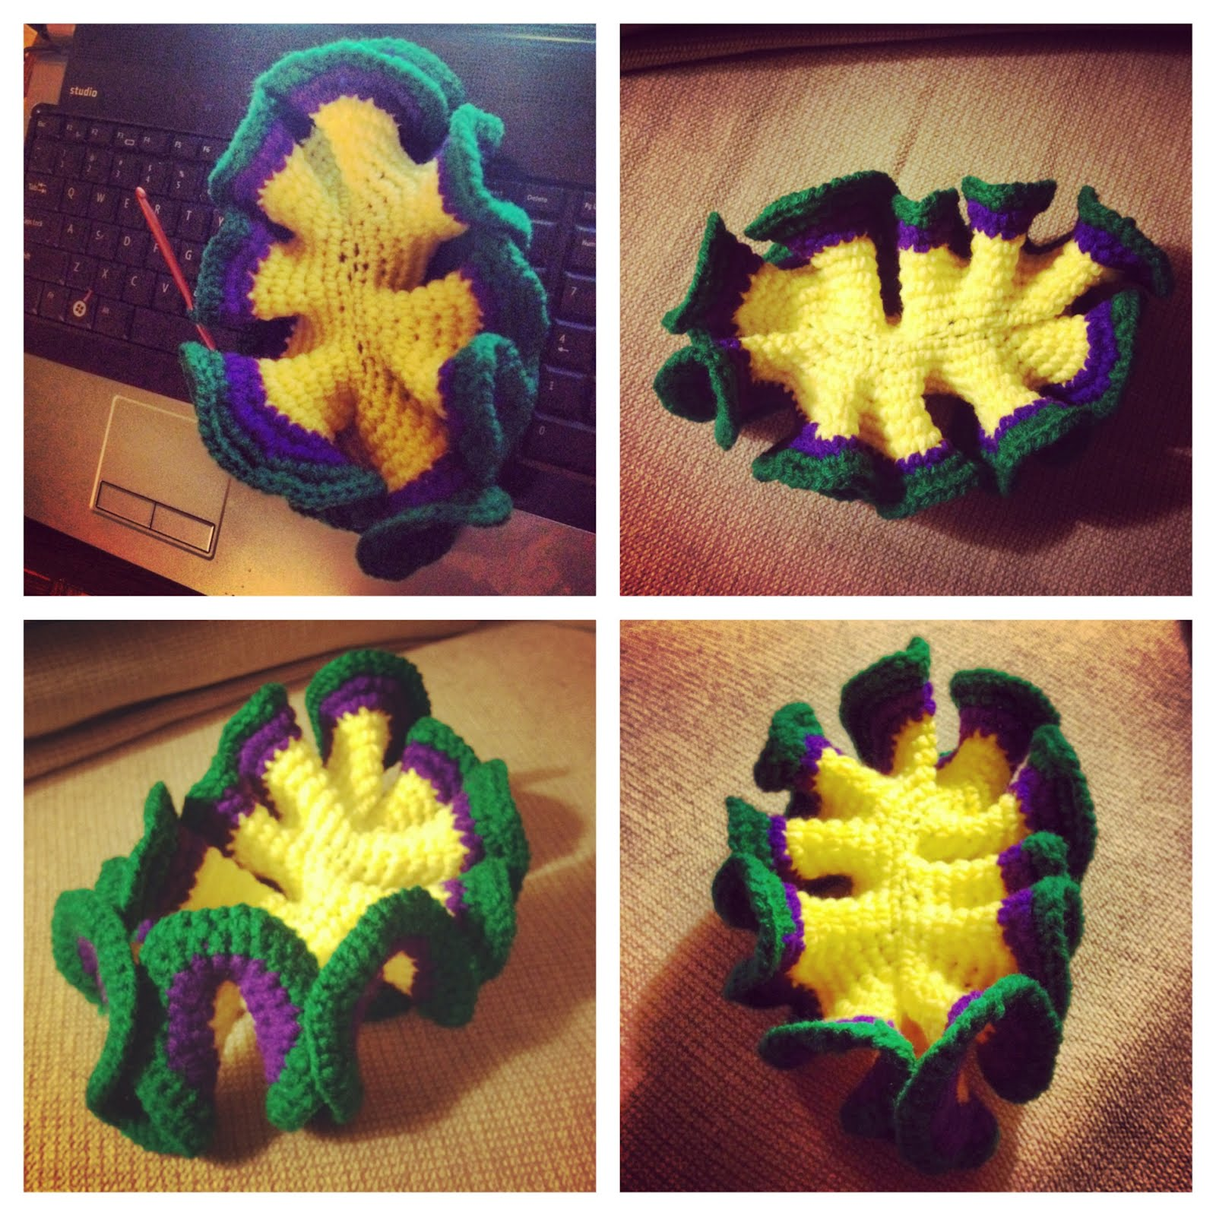
Modeling hyperbolic geometry
“Hyperbolic geometry describes surfaces that are negatively curved. Negative curvature appears in coral reefs, kale leaves and Pringles potato chips.” – Scientific American
Imagine a saddle-shape with mountain peaks and valleys
Crochet can be used to model hyperbolic geometry in three dimensions!
Hyperbolic pseudosphere (top)
and hyperbolic plane (bottom)
by Crocheting Blind
Notes:
Now, this is one of my favorite discoveries when I was researching for this project.
When making a circle or a sphere, one could say that the surface has a positive curve, but hyperbolic geometry is when the surface has a negative curve.
This is best described as looking at a saddle. The places where your legs drape over are curved downwards, but the front and back of the saddle are curved upwards.
This can be modeled pretty easily with crochet, as when you put in too many stitches, the fabric starts to warp and curl in interesting ways, making the same saddle-like shapes.
The pictures on the right are examples of this concept; they look so unnaturally natural, you know?

Slide 14
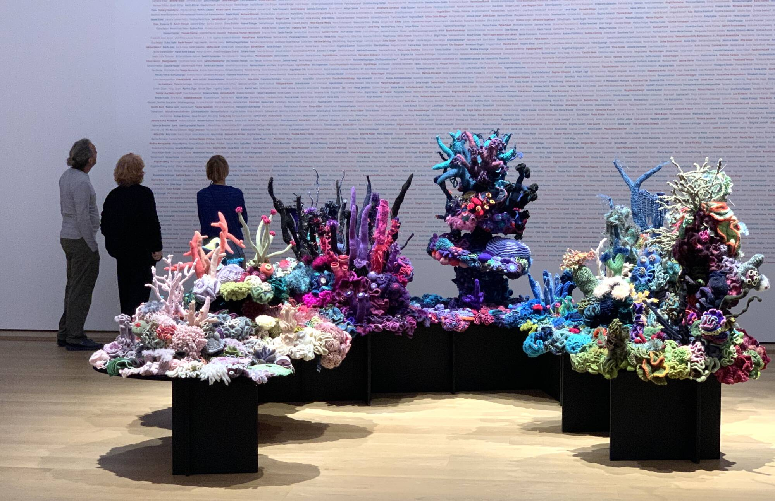
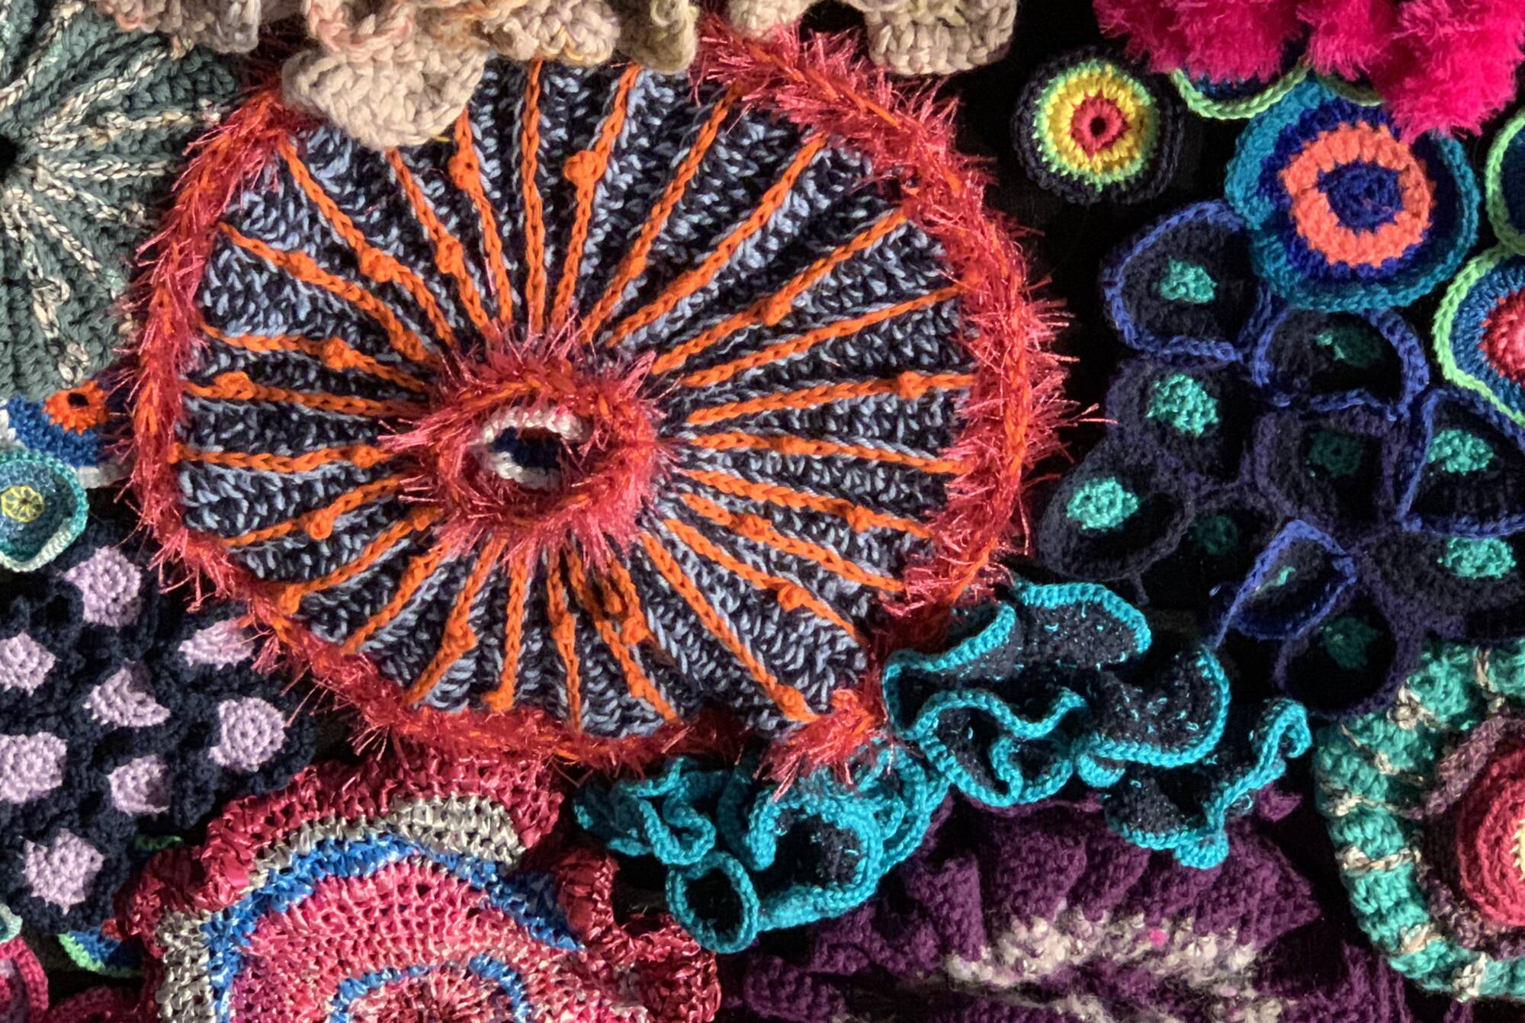
The Crochet Coral Reef
Modeling nature’s patterns with crochet
Baden Baden Satellite Reef by Margaret and Christine Wertheim
Notes:
In fact, there’s an exhibit that takes this concept to the extreme.
This is the Crochet Coral Reef!
It features all sorts of displays that replicate the various aquatic ecosystems within the ocean.
Considering that crochet cannot be replicated by machines, that means that all of this was handmade!
It is just so beautiful, and it really brings to light how diverse and strange underwater life can be.

Slide 15
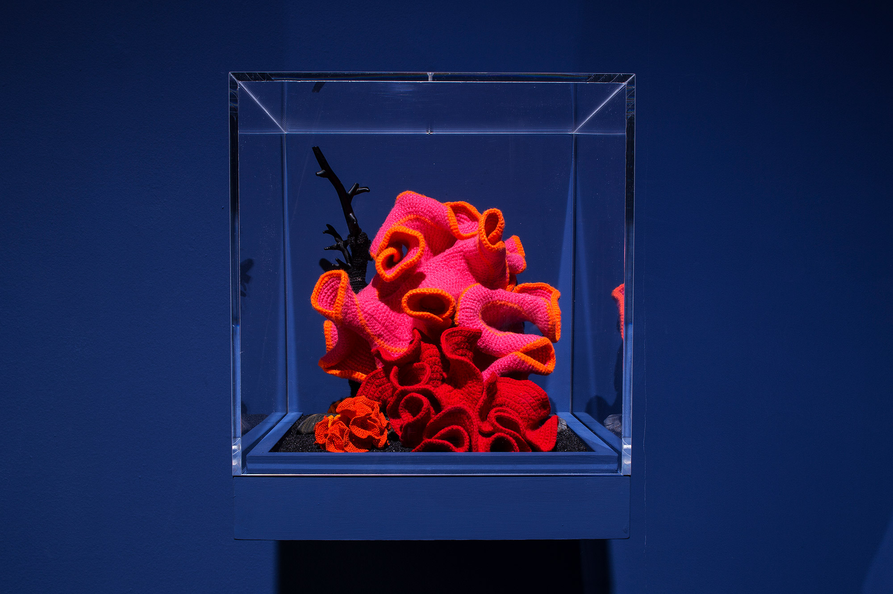
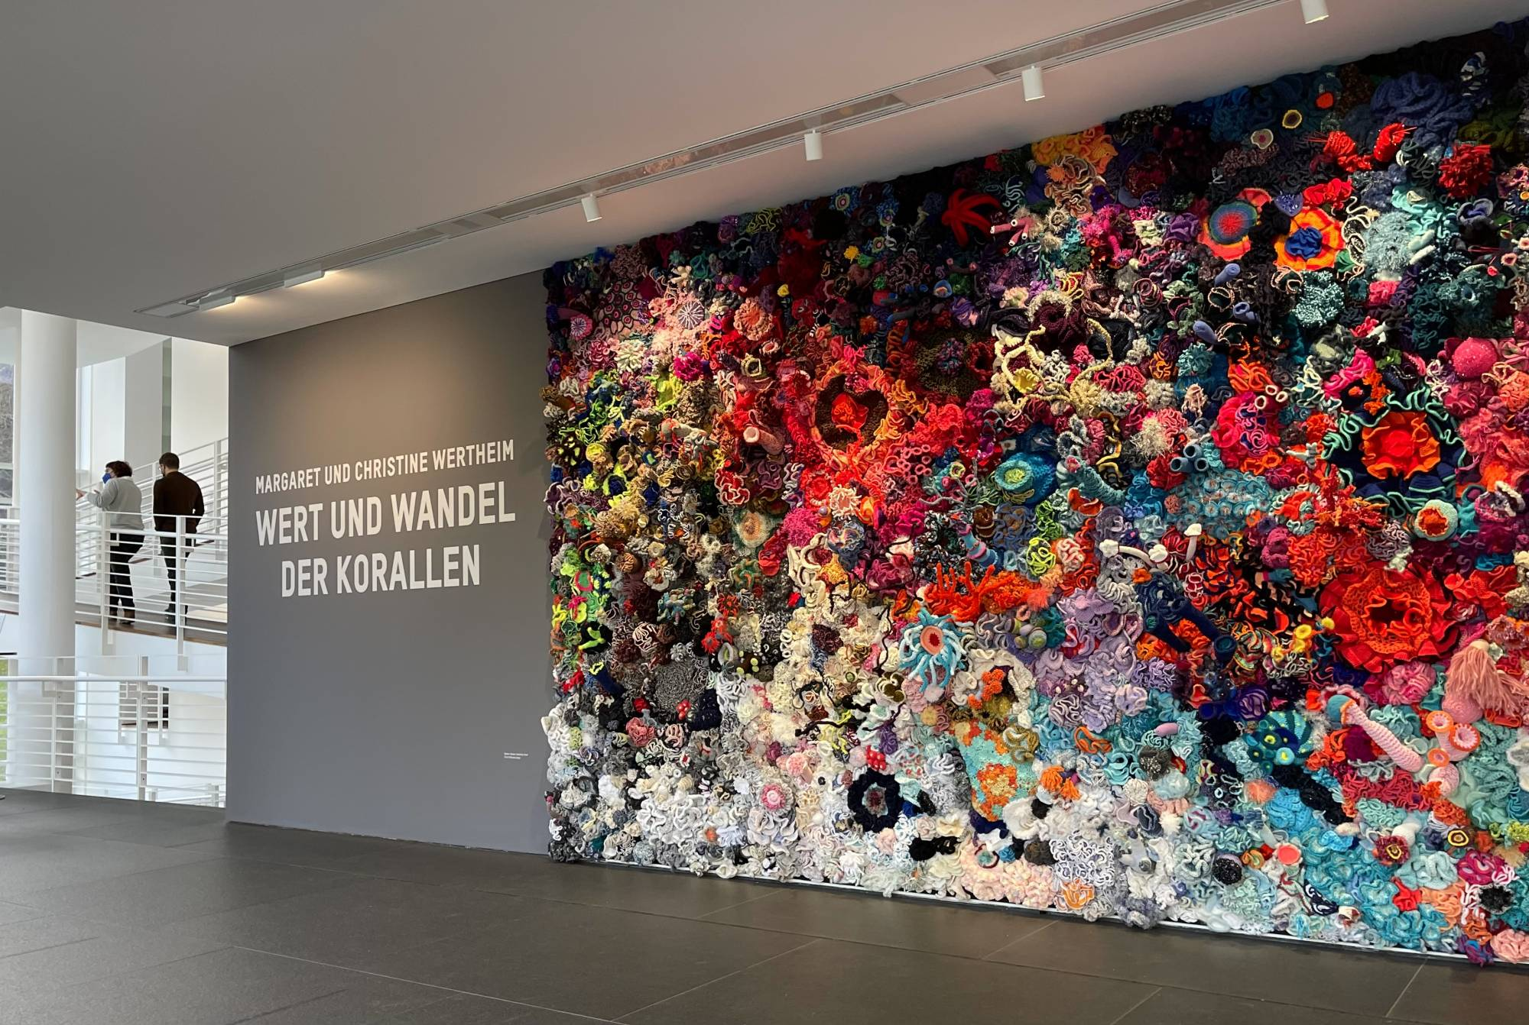
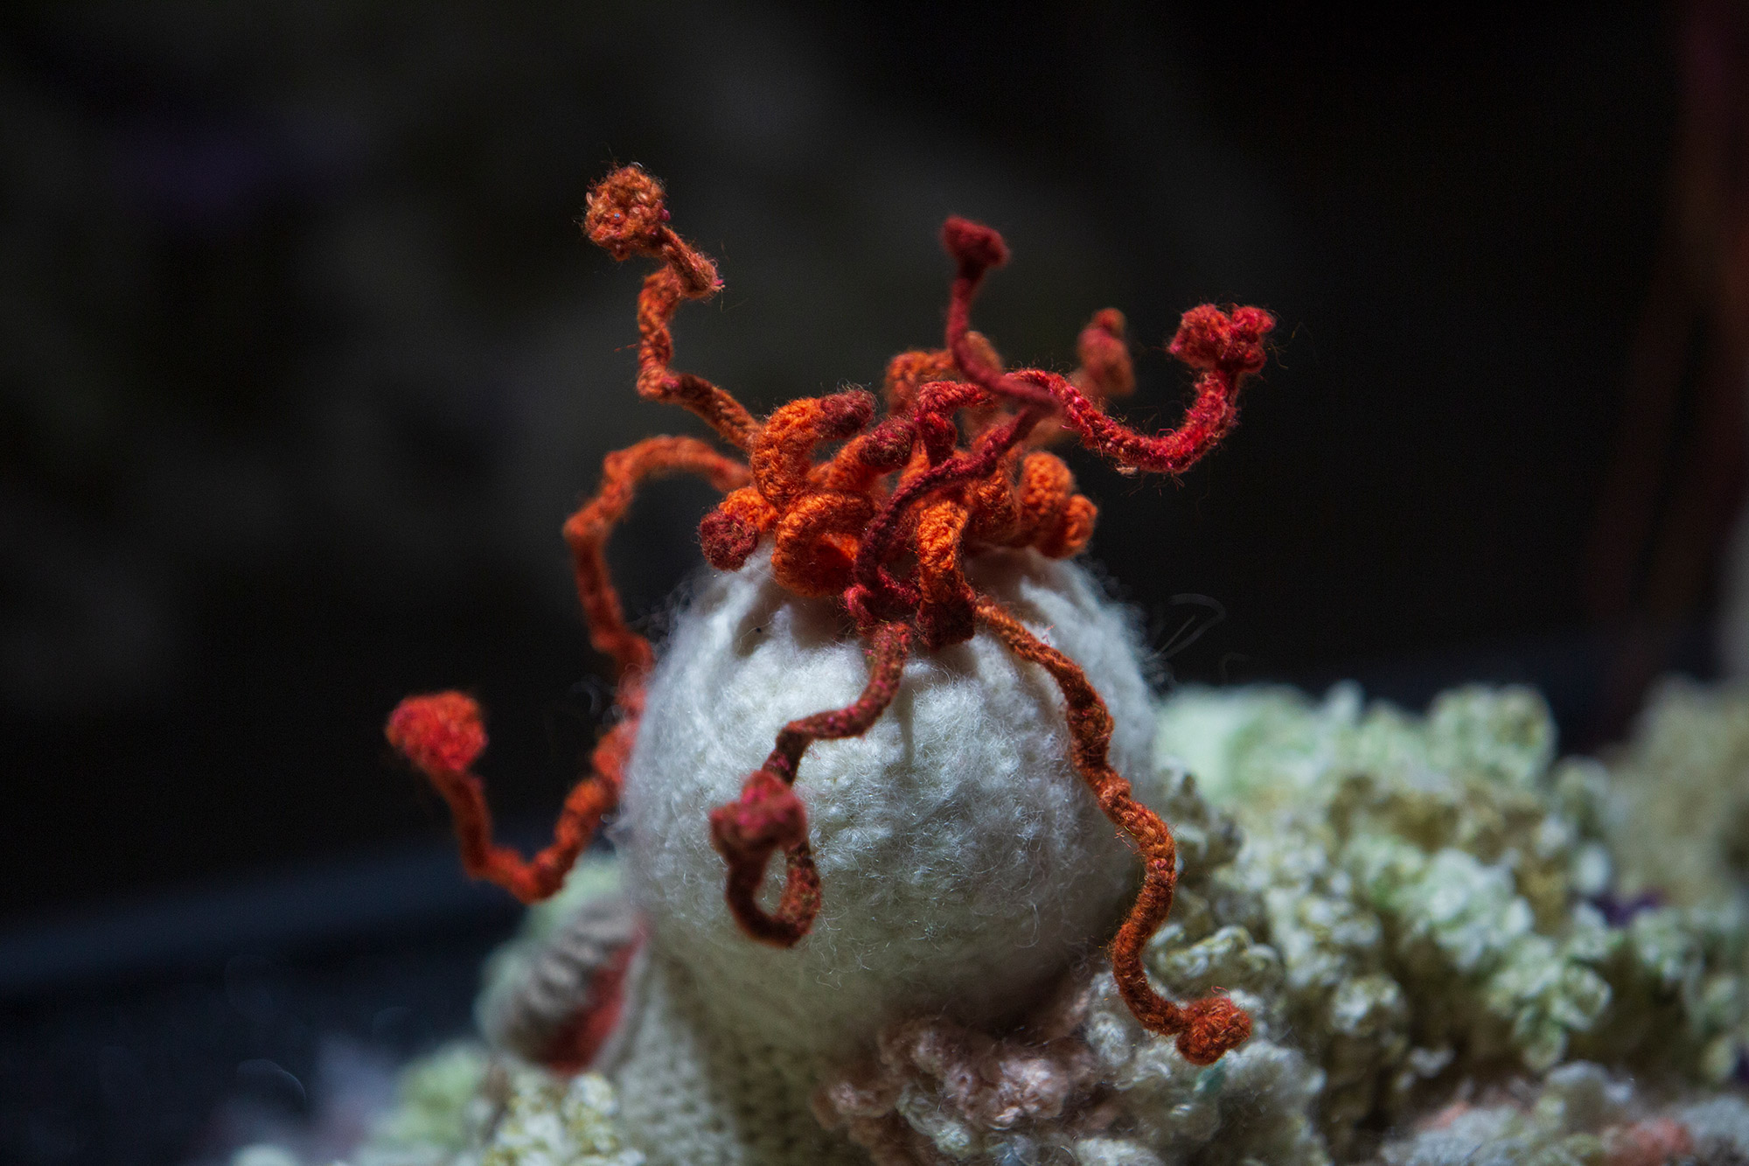
Pod World – Hyperbolic (top left), Bleached Reef detail (bottom left), and Five Fathoms Deep (above) by Margaret and Christine Wertheim
Notes:
Here are some more images of the Crochet Coral Reef.
You can really see all the different colors and threads used in these projects.
I highly encourage you to look into these works of art.

Slide 16
Making a “hyperbolic scrunchie”
Materials
Worsted weight (4) cotton yarn
Size US H8 / 5.00 mm crochet hook
Stitch markers - they help keep track of which round you are on
Hairband
Pattern
Round 0: slip stitch onto the hairband
Round 1: 1 sc, place stitch marker in first sc, 31 sc around {32 sts}
Round 2: 2 sc in each st {64 sts}
Round 3: 2 sc in each st {128 sts}
Repeat until desired size!
Notice how the number of stitches doubles every round?
Notes:
So, with all of that in mind, I was inspired to make my own pattern!
I wanted to create something that I could wear every day while being reminded of the beauty of math and crochet, and how easy it is to translate that into a repeatable algorithm.
So, I created a pattern for a hair scrunchie that looks like the hyperbolic geometry from before.
You can follow along if you want, but I’ll show you the process of how it turned out anyway!

Slide 17
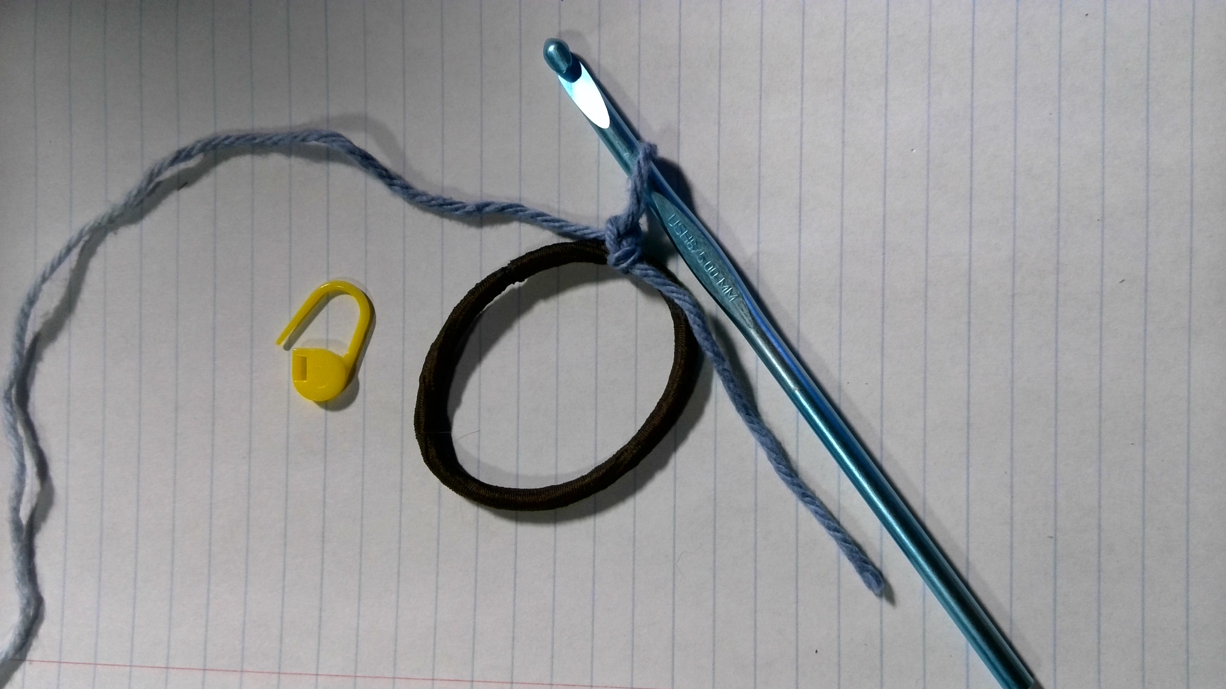
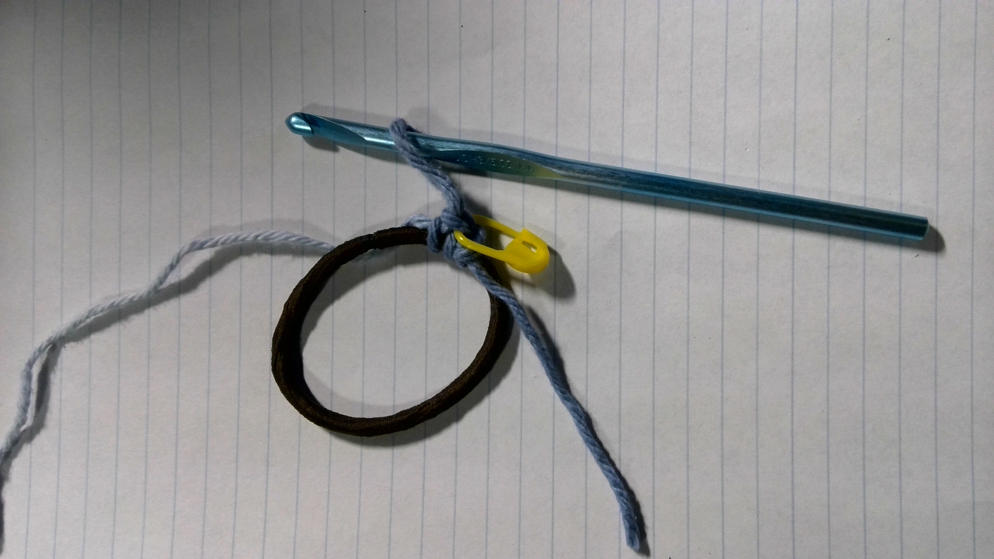
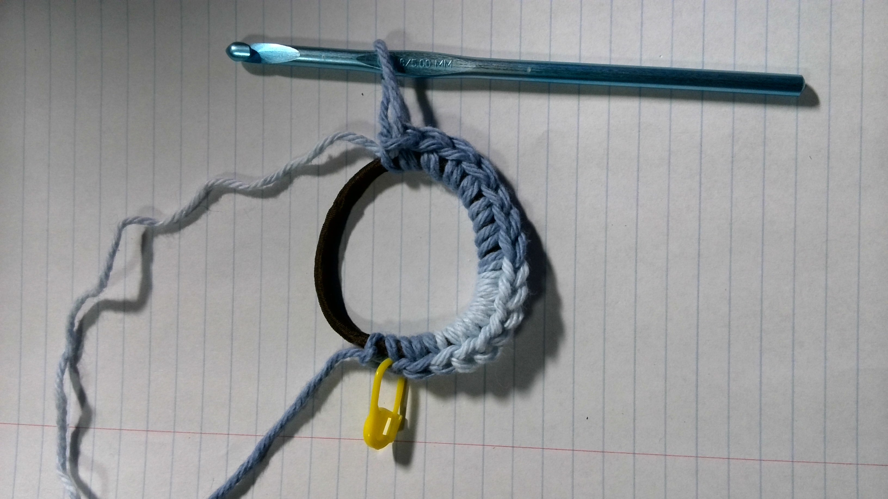
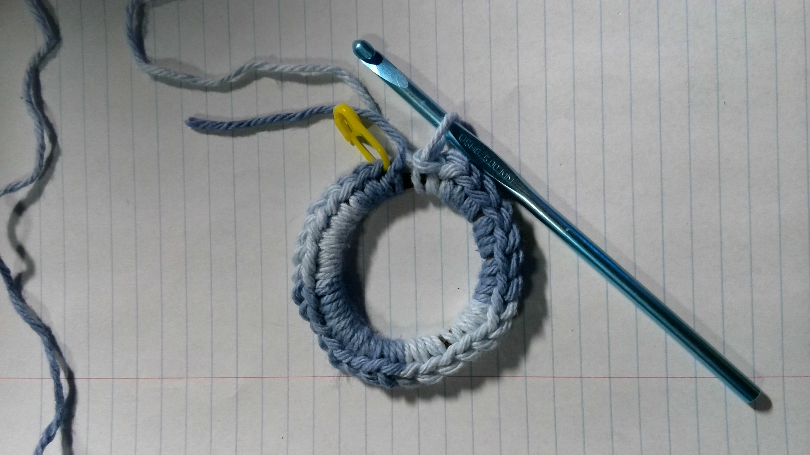
1. Making a slip stitch attached to the hairband
2. Starting Round 1 by attaching the stitch marker to the first sc
3. Halfway through Round 1 {16 sts}
4. Round 1 is done! {32 sts}
Notes:
First, I attached the yarn to the hairband with a slip stitch. I have a stitch marker as well to help me keep track of how many rounds I’ve made.
Next, I made a single crochet and put the stitch marker through it.
The hairband I had seemed to fit 32 single crochet, which I thought was nice because I could increment the number of stitches by numbers in base 2.
When I finished the first round, the hairband looked very round and all the stitches fit very snugly.

Slide 18
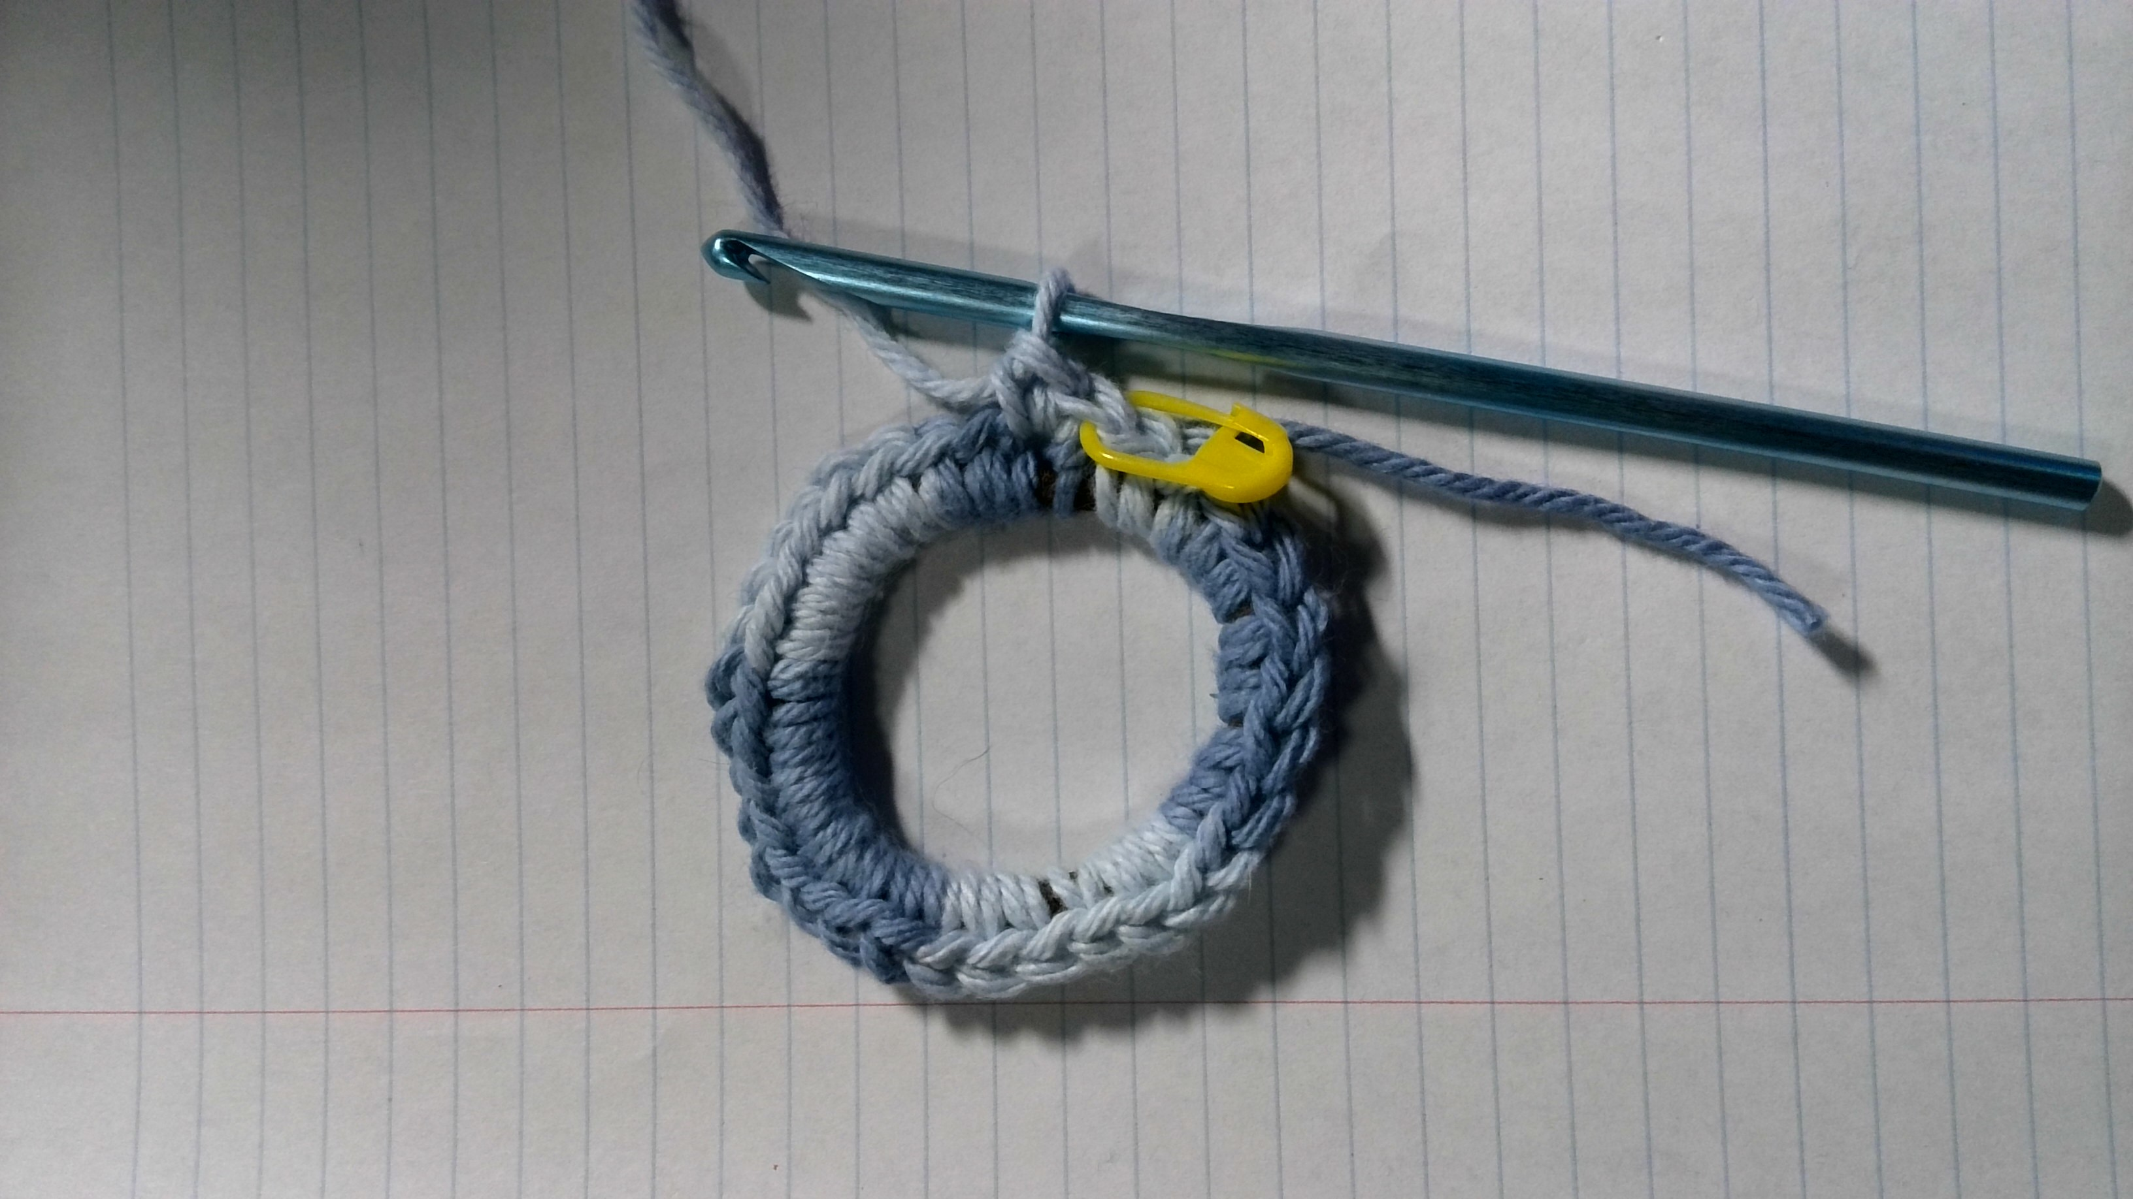
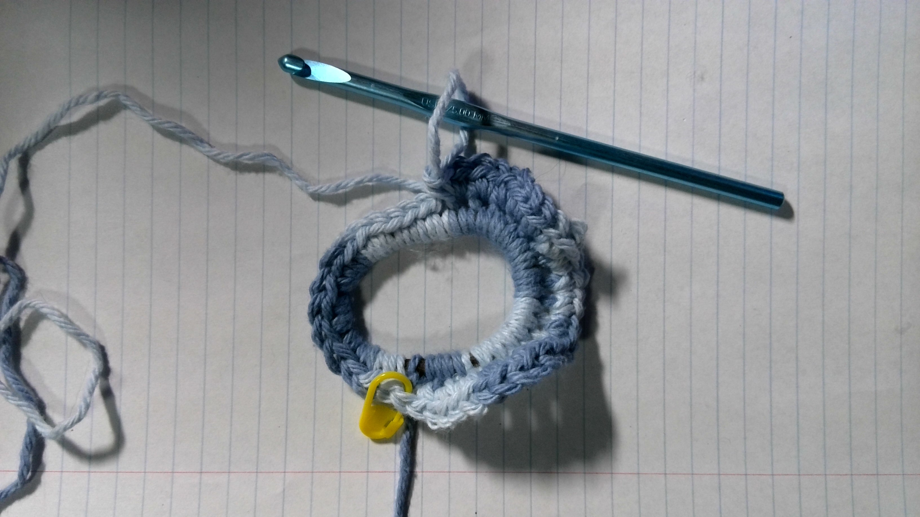
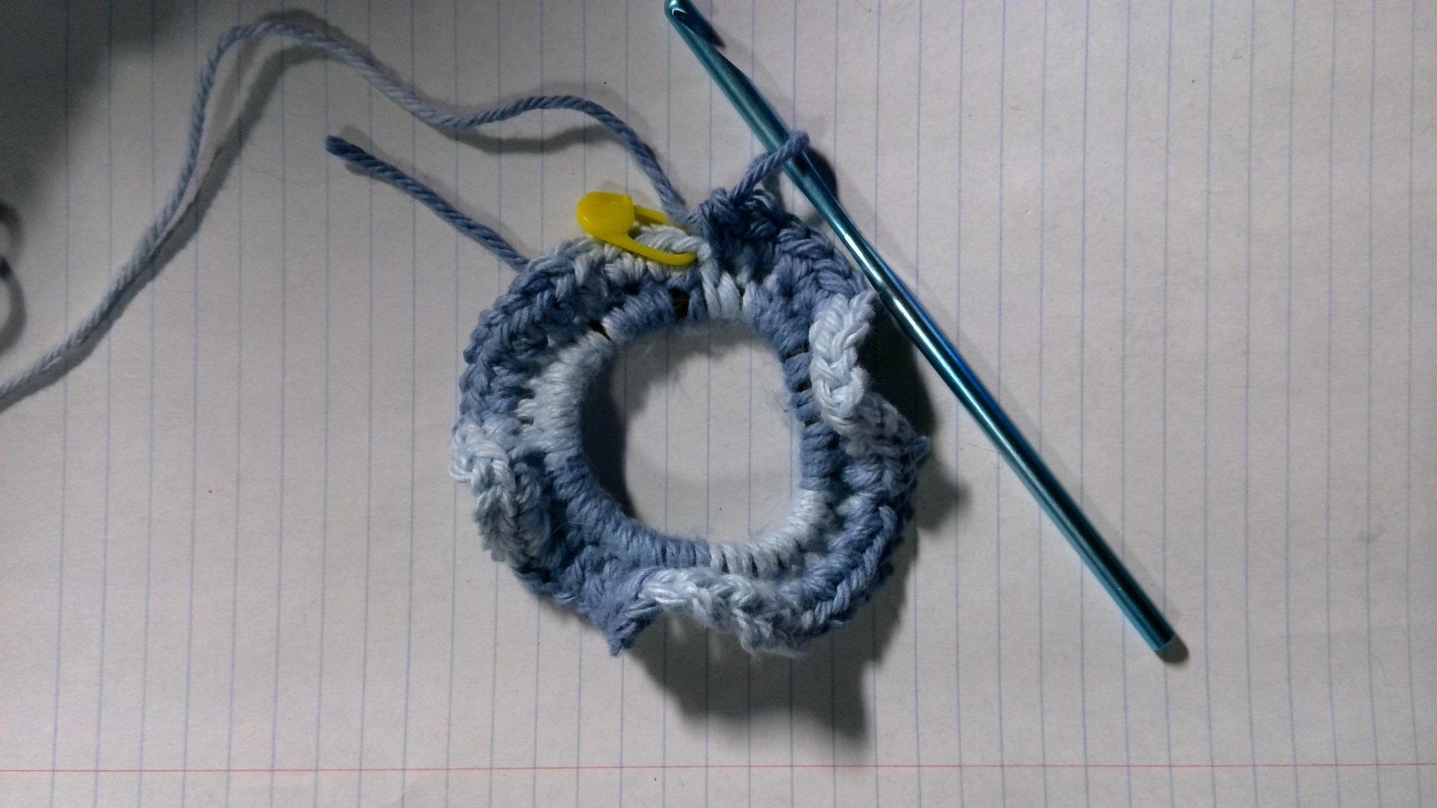
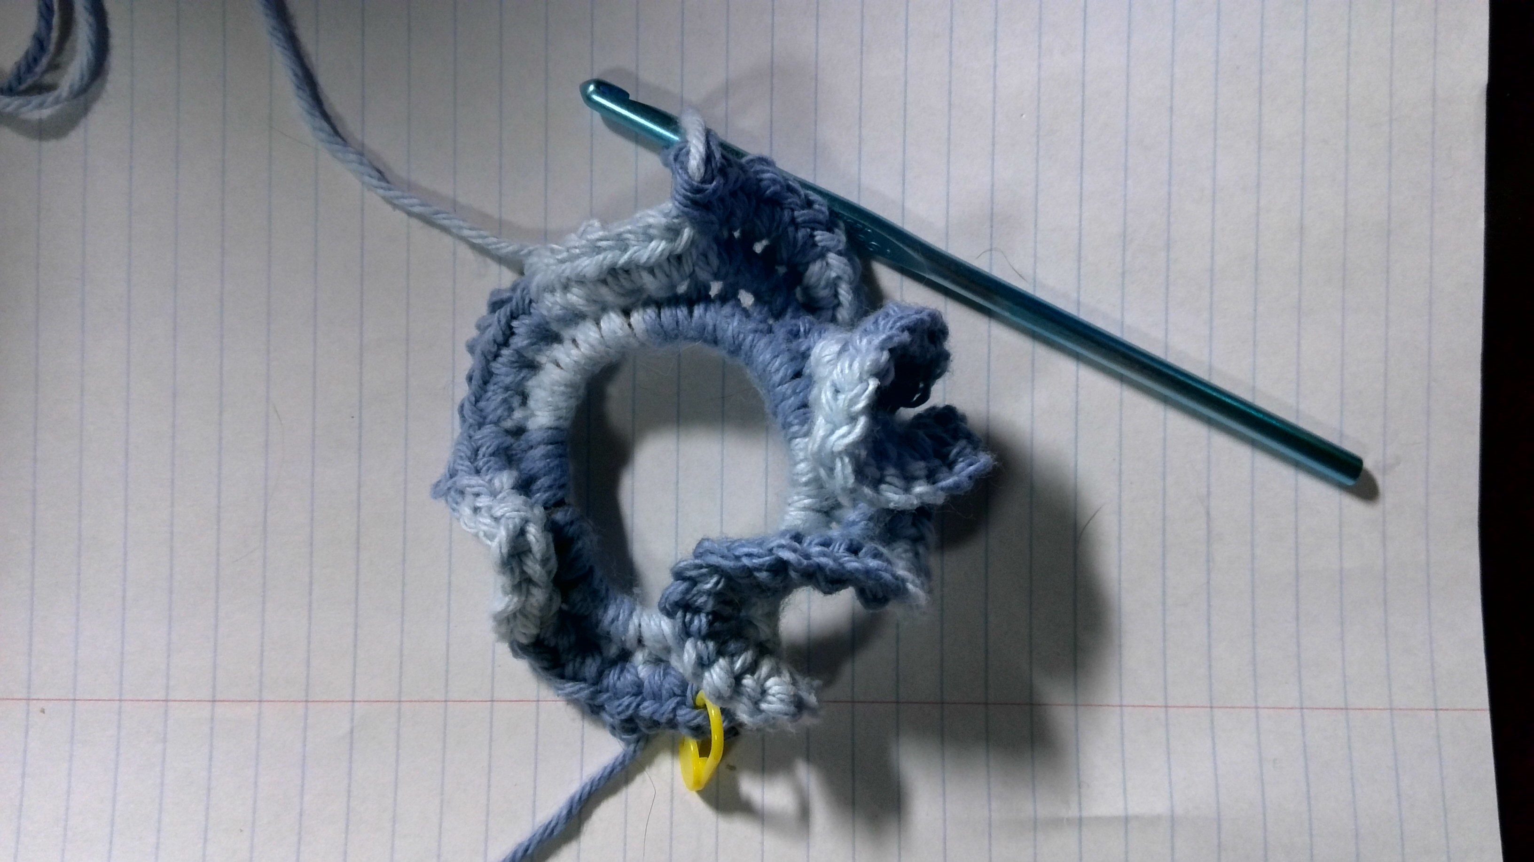
5. Starting Round 2 by moving the stitch marker to our first increase (2 sts in one)
6. Halfway through Round 2, the fabric is starting to ripple {32 sts}
7. Round 2 is done! {64 sts}
8. Halfway through Round 3, saddle shapes are becoming deeper {64 sts}
Notes:
5. When starting the second round, you want to take off the stitch marker, make your next stitch, then place the stitch marker in the stitch you just made. Make another stitch in that same space, and you’ve made an increase!
6. Continuing that sequence, making two stitches in each space, the fabric starts to warp and curl.
7. By the time I finished the second round, the hairband was no longer laying flat…
8. …and the third round emphasized the saddle shapes that were beginning to form.

Slide 19
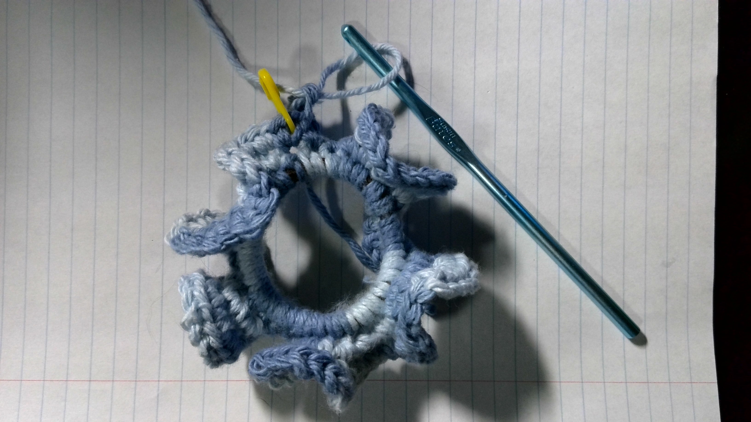
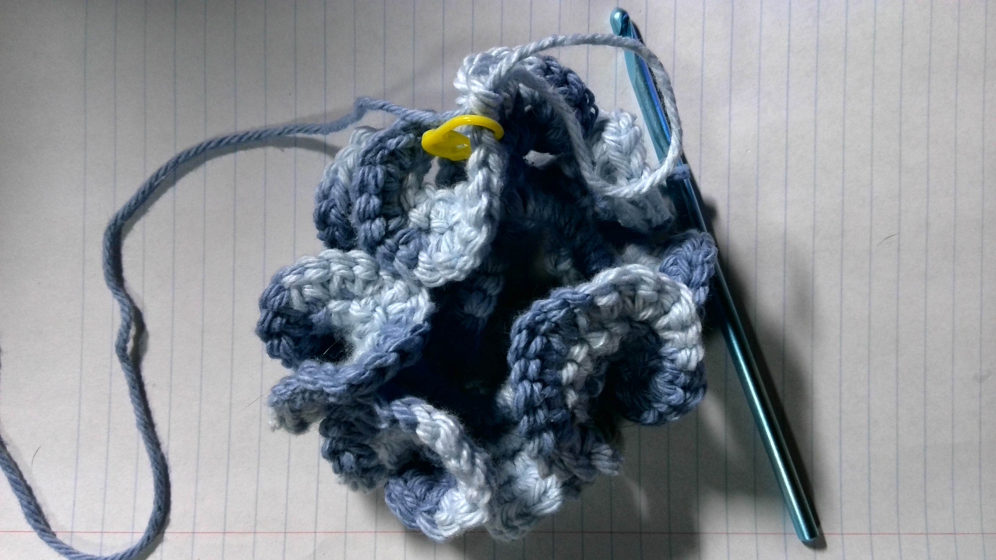
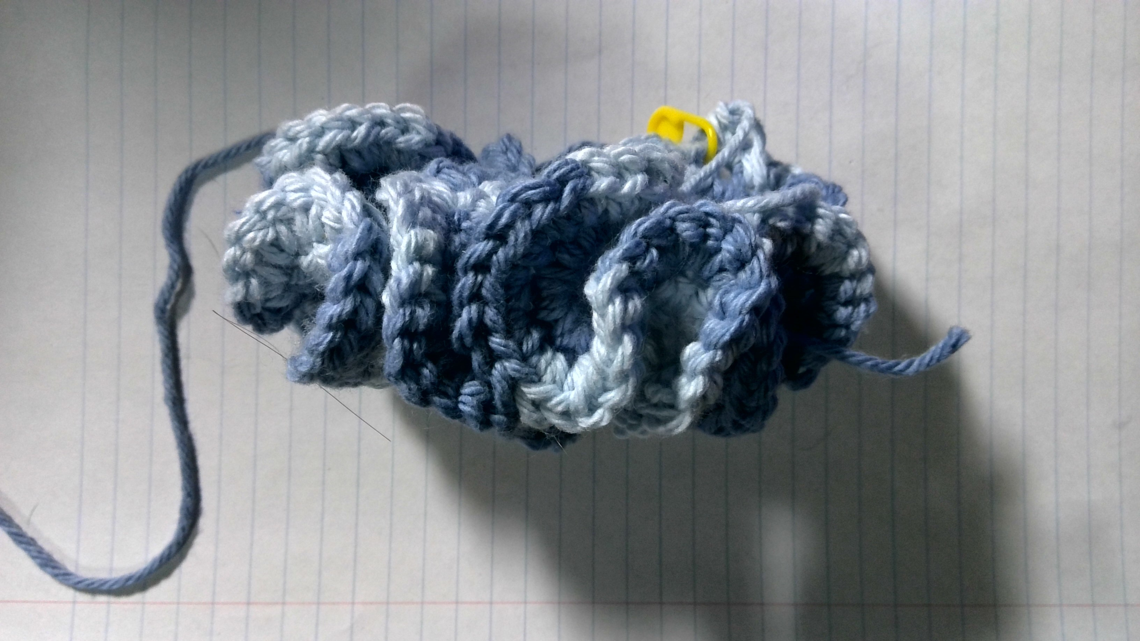
9. Round 3 is done! {128 sts}
10. Round 4 is done! My hand is cramping up… {256 sts}
11. Side profile of the finished scrunchie, saddles are very deep
Notes:
9. When I finished the third round, the ripples were very defined, and it almost looks like a weird flower!
10. By the fourth round, I had made 256 stitches all the way around, plus the 128 stitches from the round before, plus the 64 stitches from the round before that, PLUS the 32 stitches I had made in the beginning!
11. You can do the math on that. At that point my hand was starting to cramp, and considering that each round used twice the amount of yarn and twice the amount of time as the previous round, I felt that this was large enough.

Slide 20
Conclusion
Crochet is an excellent artform for modeling mathematical concepts
Reading and writing crochet patterns is the same process as developing an algorithm or coding a program; after all, programming came from fiber arts!
Notes:
So, to conclude!
I feel that crochet can be used very well to demonstrate advanced mathematical concepts.
I find it very fun to be able to create fabric from just yarn and a hook, and it’s even more fun designing your own patterns and creating interesting shapes.
Making your own patterns, or even just writing them, is the same process as creating an algorithm or program.
It’s the same thought process, because after all, one of the first “computers” was a revolutionary weaving machine.
Programming and fiber arts will always be interwoven.

Slide 21
Sources
Club Crochet: How to Crochet the Bobble Stitch
Chalkdust Magazine: Crocheting Fractals
Crochet Coral Reef: Gallery
Crocheting Blind: Crochet Projects: Hyperbolic Plane and Pseudosphere
Desert Blossom Crafts: Jasmine Stitch Crochet Tutorial
Elise Rose Crochet: Crochet’s Secret History Revealed
Fractal Foundation: What are Fractals?
Hooked by Kati: Basic Amigurumi Shapes: The Shape is in the Math!
Interweave: Crochet Throughout History
Mama in a Stitch: How to Crochet the Granite or Moss Stitch, Waffle Stitch Crochet Blanket Pattern
Meriam Webster: Crochet Definition & Meaning
Ms. Premise-Conclusion: The Ideal Crochet Sphere
Piecework Magazine: Victorian Crochet: A Sport of Its Own
Runestone Academy: Sierpinski Triangle
Science and Industry Museum: Programming Patterns: The Story of the Jacquard Loom
Scientific American: A Mathematical Yarn: How to Stitch a Hyperbolic Pseudosphere
Shelley Husband Crochet: The Secret Crochet Circle Formula
Wikipedia: Amigurumi
Notes:
Here are all the sources I linked to within the presentation. Thank you for watching!

